Slide 1
Affinity Groups 2024 Update
Data Values from 1/1/2024 ArcGIS Service
https://gis.imb.org/arcgis/rest/services/YEAR
Notes:
IMB work around the world is organized by Affinity Groups. Affinity Groups are collections of people who share a sense of kinship based on language, religion, culture, or history. They are usually indigenous to a geographic region.

Slide 2
Affinity Groups
Copyright © 2024 IMB, Global Research
Notes:
While peoples from each Affinity can be found anywhere in the world, this map assigns countries to a single Affinity based on people group population. Note that the Deaf Affinity is not represented on this map. Though Deaf peoples are found in every country and among every major people group, they do not comprise a majority in any country.
The series of maps that follow highlight each Affinity, showing countries where people group population from the Affinity makes up more than half of the country population compared to countries where people group population from the Affinity make up less than half of the country population.

Slide 3
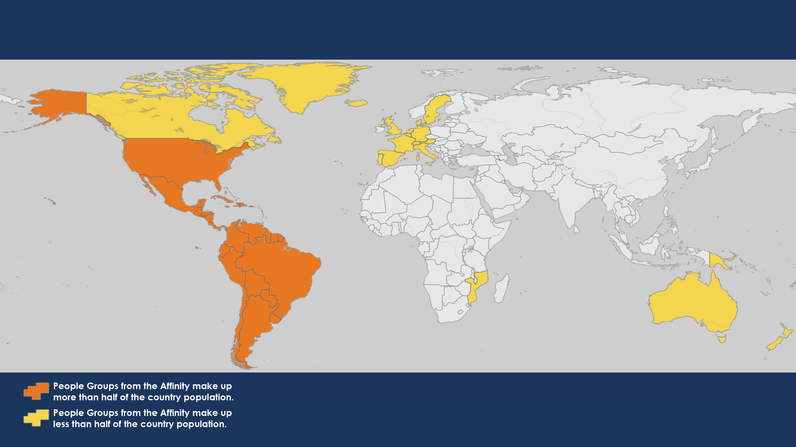
American Peoples
American Peoples
1,333 People Groups with a combined population of 939 million
47 million evangelical believers
Copyright © 2024 IMB, Global Research
Notes:
The American peoples have a rich heritage of missions, yet nearly 900 million are living without Jesus. Most of these people live in majority Catholic countries. Thirteen of the 100 most populous cities in the world are found in the Americas, yet one of the greatest challenges is the large number of micro-peoples—small, isolated, indigenous groups with little to no contact with the outside world.

Slide 4
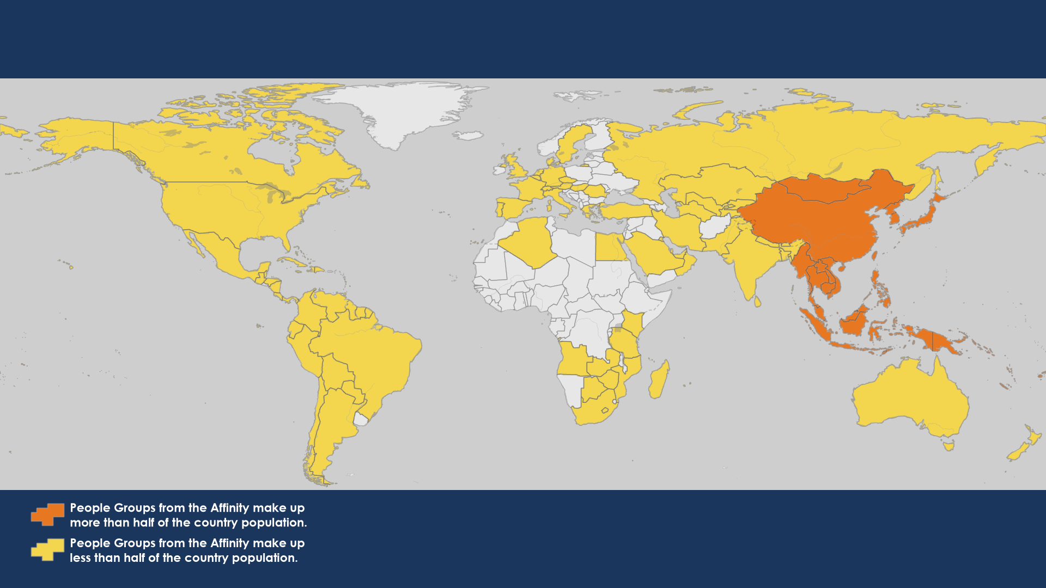
Asian Pacific Rim Peoples
Asian Pacific Rim Peoples
3,379 People Groups with a combined population of 2.3 billion
99 million evangelical believers
Copyright © 2024 IMB, Global Research
Notes:
The Asia-Pacific rim encompasses 2.34 billion people, concentrated in 41 countries ranging from densely populated China and Indonesia to sparsely populated and remote island nations. A majority of the world’s Buddhists live in this part of Asia; only 4.2% of people in the Asia-Pacific rim are followers of Jesus. More than half of the world’s largest cities are found within this affinity.

Slide 5
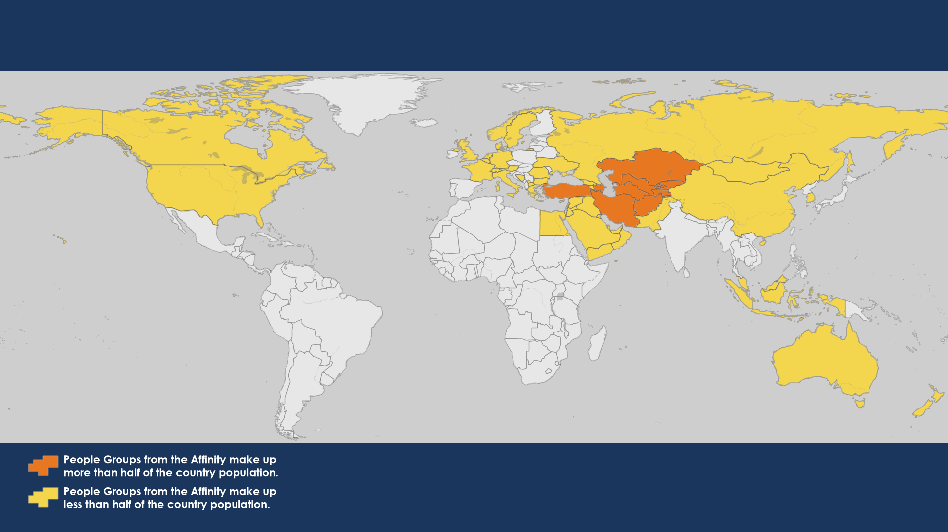
Central Asian Peoples
Central Asian Peoples
394 People Groups with a combined population of 386 million
302 thousand evangelical believers
Copyright © 2024 IMB, Global Research
Notes:
Almost all the Persian and Turkic people who call Central Asia home are unreached. Most Central Asians have no knowledge of biblical Christianity and are unaware that the gospel is good news. Most the countries within Central Asia are either Islamic states—governed by Sharia law—or secular states with Islam defined as the state religion.

Slide 6
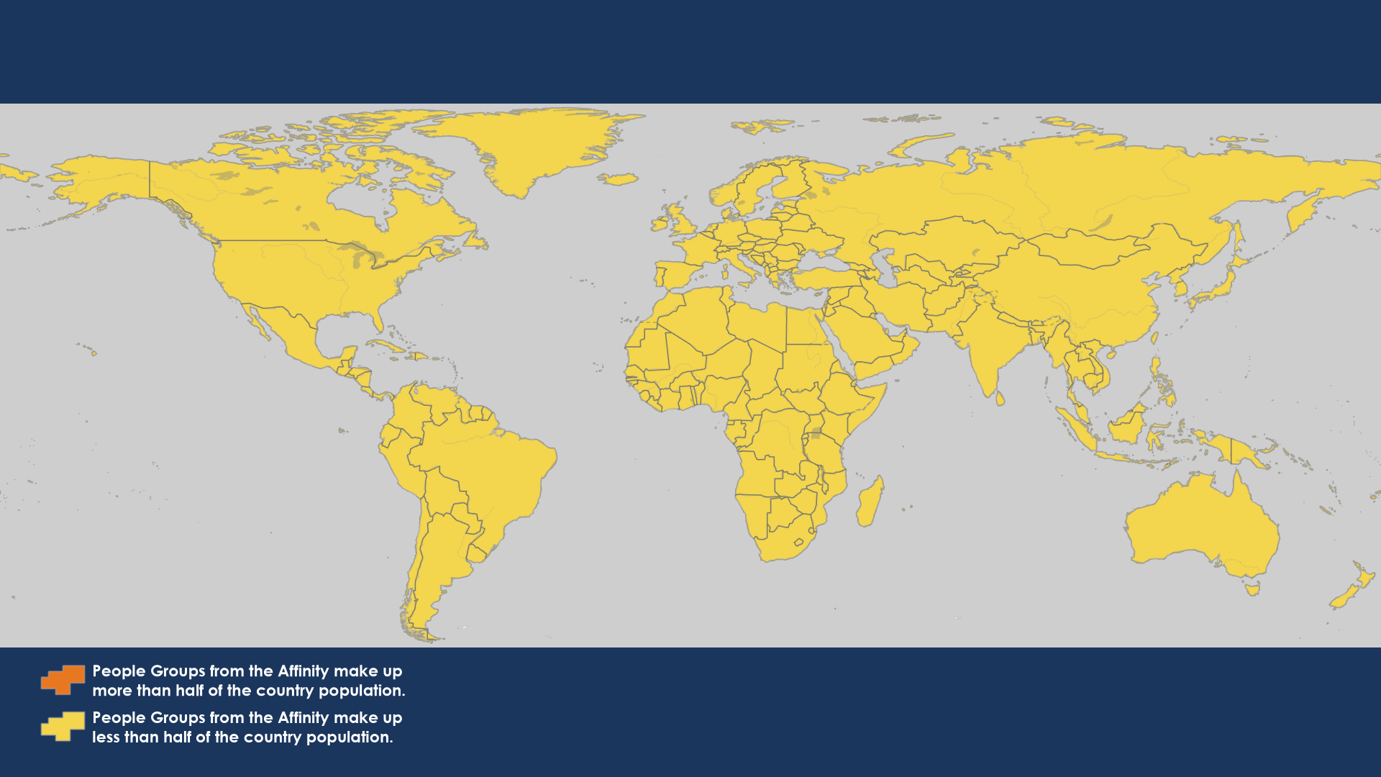
Deaf Peoples
Deaf Peoples
234 People Groups with a combined population of 75 million
210 thousand evangelical believers
Copyright © 2024 IMB, Global Research
Notes:
Most of the 75 million deaf people around the world have never seen Jesus’ name signed in their language. Often ignored and oppressed, the deaf are some of the least evangelized people on earth. Although there are 300 different sign languages, many are connected by similarities called sign roots—common facial expressions, body movements, and hand signs. IMB missionaries are using sign roots to translate Bible stories into the most widely used sign languages.

Slide 7
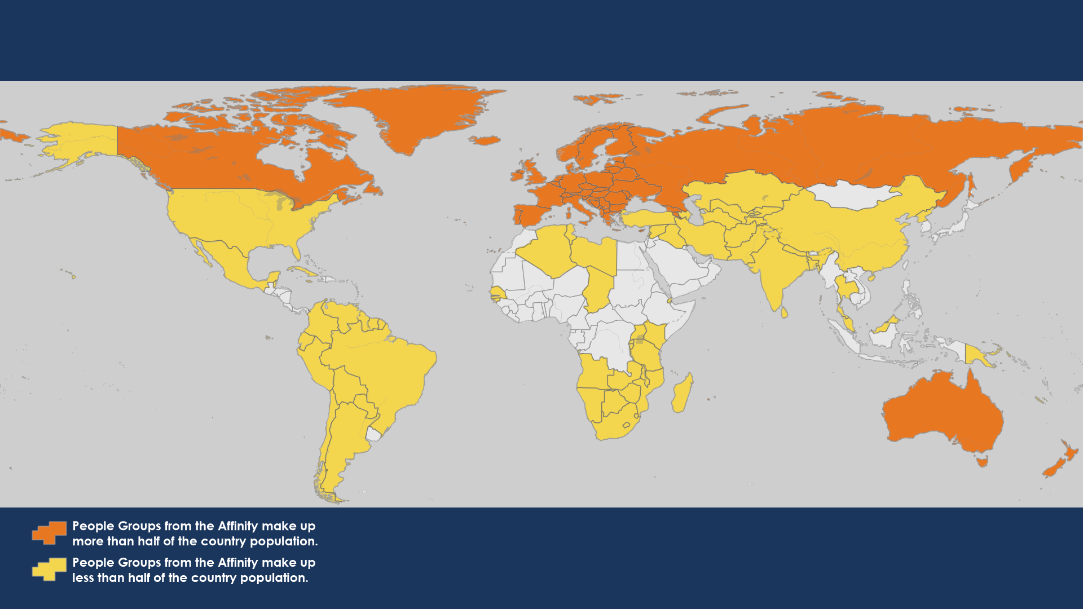
European Peoples
European Peoples
691 People Groups with a combined population of 782 million
8.7 million evangelical believers
Copyright © 2024 IMB, Global Research
Notes:
Europe is known for its history, architecture, and art. But what most people don’t know about Europe is the deep need for the gospel. Less than 1.1% of Europeans are evangelical Christians. Believers in Europe have the God-given task of sharing the gospel with the 98.9% who do not yet know Jesus. Your IMB missionaries work alongside local churches, seminaries, and individual believers to train and equip Christians in Europe to share the gospel and form new churches.
Note: Countries in white have no reported people groups from the highlighted affinity in the IMB database.

Slide 8
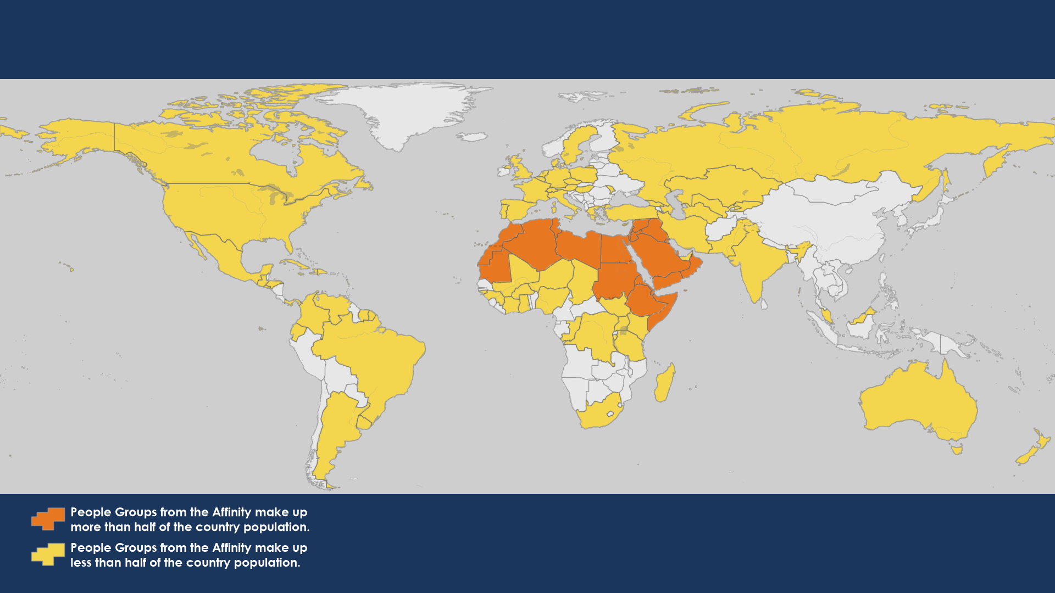
Northern African and Middle Eastern Peoples
Northern African and Middle Eastern Peoples
813 People Groups with a combined population of 614 million
8.4 million evangelical believers
Copyright © 2024 IMB, Global Research
Notes:
Northern African and Middle Eastern peoples live in a place where history blends with the modern world. The birthplace of Judaism, Christianity and Islam—the Abrahamic religions—daily life is dominated by Islam. A region of princes and paupers, here the church is engaged in a captivating resurgence unlike any other.

Slide 9
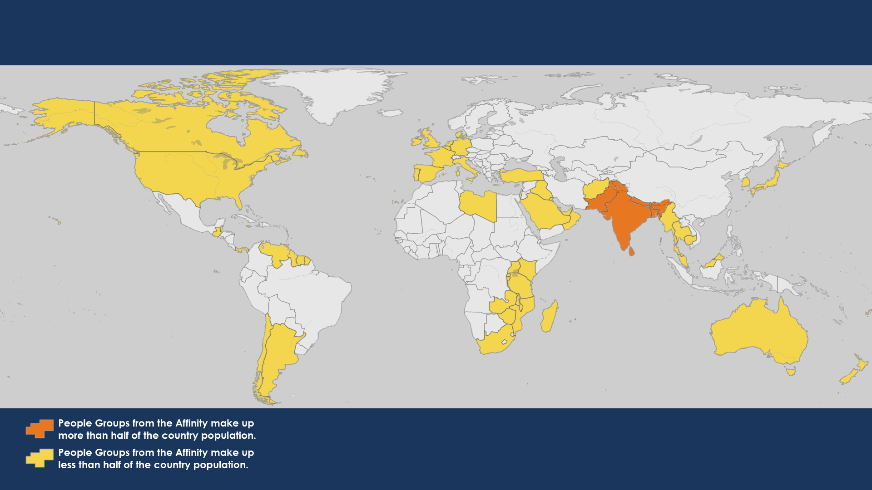
South Asian Peoples
South Asian Peoples
2,678 People Groups with a combined population of 1.9 billion
23 million evangelical believers
Copyright © 2024 IMB, Global Research
Notes:
From the heights of the mighty Himalayas to the crystal-clear water of the Maldives, South Asia is both awe-inspiring and heart-wrenching. It has the largest concentration of non-Christians on the planet. South Asia is home to more than 500 million Muslims and is the birthplace of Hinduism, Buddhism, Sikhism, and Jainism. The 1.9 billion people of South Asia are concentrated in an area less than half the size of the USA.

Slide 10
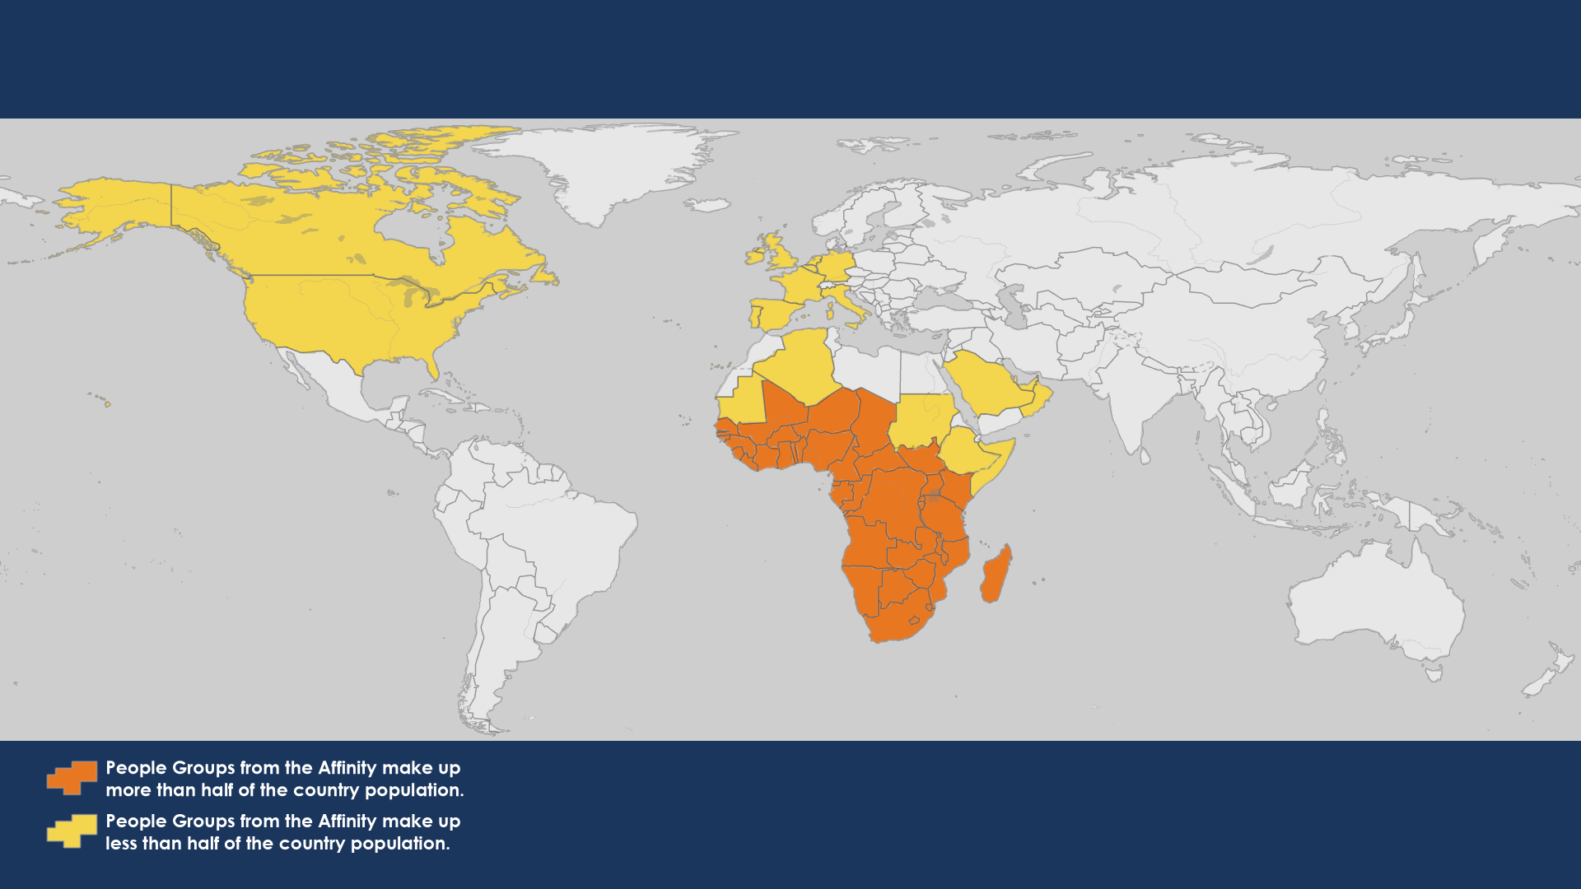
Sub-Saharan African Peoples
Sub-Saharan African Peoples
2,592 People Groups with a combined population of 999 million
36 million evangelical believers
Copyright © 2024 IMB, Global Research
Notes:
Sub-Saharan African peoples have a growing Christian population, yet nearly 1,600 unreached people groups remain in sprawling cities, barren deserts, rain forests, and tropical islands. Currently 41% urban, by most estimates Africa will be 60% urban by the year 2050.

