Slide 1
Global Status of Evangelical Christianity 2023 Update
Data Values from 1/1/2023 ArcGIS Service
https://gis.imb.org/arcgis/rest/services/YEAR
Explore an Interactive version of the latest GSEC Map.

Slide 2
Global Status of Evangelical Christianity
The Global Status of Evangelical Christianity (GSEC) map portrays the spread of the gospel among people groups by measuring:
percentage of evangelicals;
access to evangelical print, audio, visual, or human resources;
recent church planting activity.
The GSEC model provides critical information for strategic decision makers.
Learn more at: peoplegroups.org
Status | Description
0 | No evangelical Christians or churches. No access to evangelical print, audio, visual or human resources.
1 | Less than 2 percent evangelical. Some evangelical resources available. No active church planting within the past two years.
2 | Less than 2 percent evangelical. Initial or localized church planting within the past two years.
3 | Less than 2 percent evangelical. Dispersed or widespread church planting within the past two years.
4 | Greater than or equal to 2 percent evangelical.
5 | Greater than or equal to 5 percent evangelical.
6 | Greater than or equal to 10 percent evangelical.
Notes:
The Global Status of Evangelical Christianity helps us understand how the gospel spreads among people groups by comparing the percentage of evangelicals, the availability of evangelical resources, and reports of recent church planting activity for each people group.

Slide 3
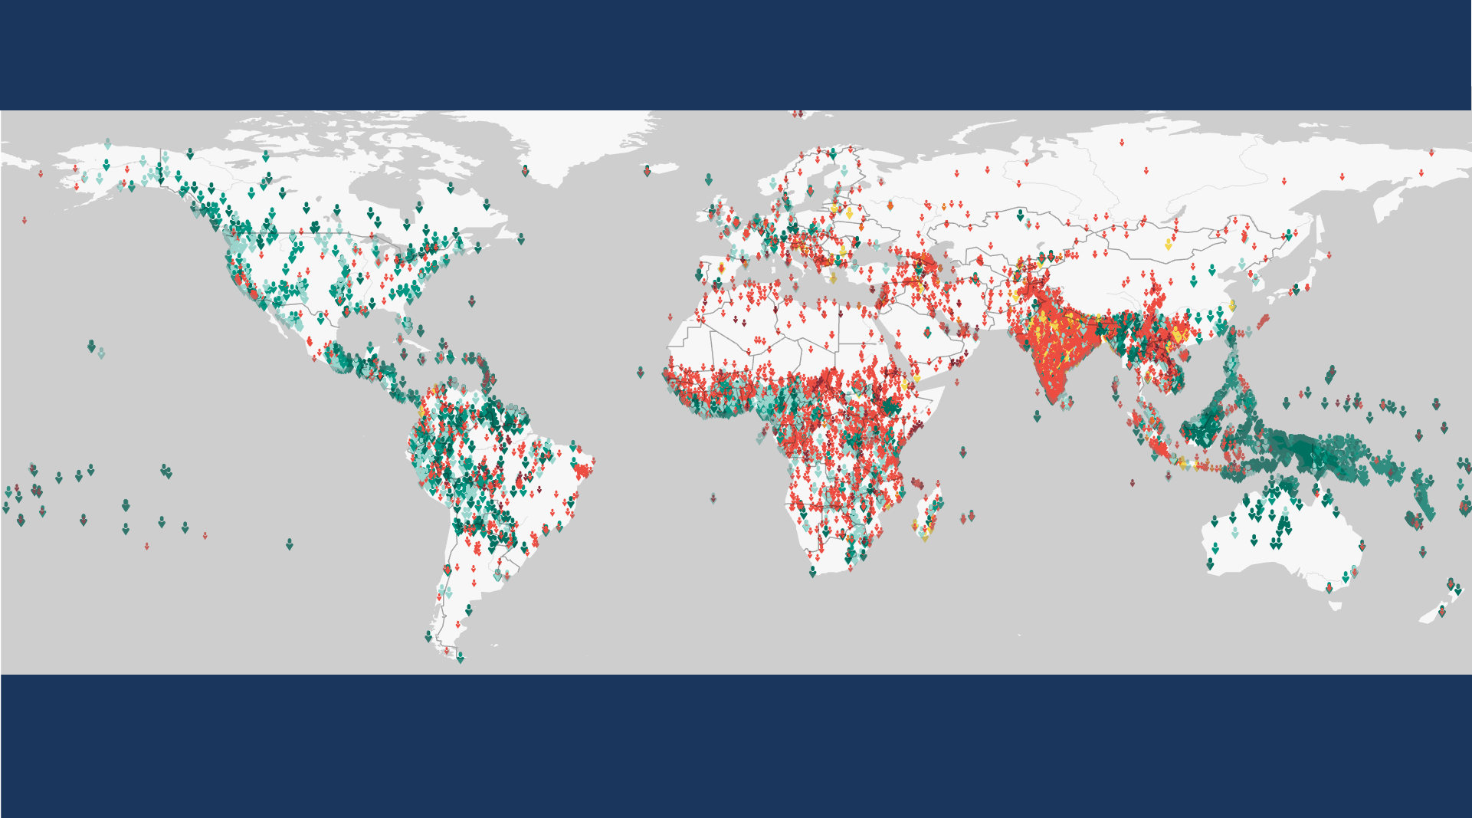
Global Status of Evangelical Christianity
12,019 people groups with a combined population of 8 billion
are included in the IMB database as of January 2023.
Each symbol represents a people group. GSEC values calculated by Global Research, IMB, January 2023. Plate Carrée Projection. Human Geography Basemap by ESRI.
Copyright © 2023 International Mission Board, Global Research
Notes:
12,019 people groups with a combined population of 8 billion are included in the IMB database as of January 2023. Each people group is represented by a single symbol.

Slide 4
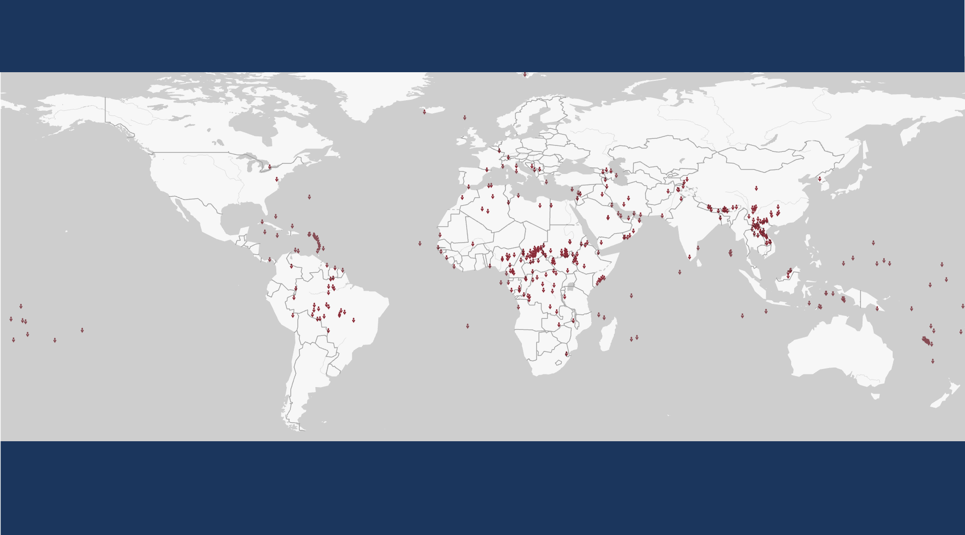
Global Status of Evangelical Christianity
GSEC Status 0
No evangelical Christians or churches.
No access to evangelical print, audio, visual or human resources.
366 people groups with a combined population of 11,745,408 as of January 2023.
Each symbol represents a people group. GSEC values calculated by Global Research, IMB, January 2023. Plate Carrée Projection. Human Geography Basemap by ESRI.
Copyright © 2023 International Mission Board, Global Research
Notes:
366 people groups with a total population of 11,745,408 are classified as GSEC 0 as of January 2023. GSEC 0 people groups have no evangelical Christians or churches and no access to evangelical print, audio, visual or human resources.

Slide 5
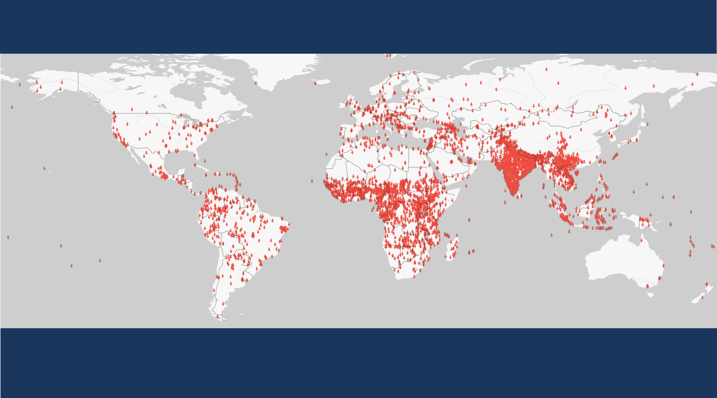
Global Status of Evangelical Christianity
GSEC Status 1
Less than 2 percent evangelical. Some evangelical resources are available.
No active church planting within the past two years.
6,449 people groups with a combined population of 3,420,196,765 as of January 2023.
Each symbol represents a people group. GSEC values calculated by Global Research, IMB, January 2023. Plate Carrée Projection. Human Geography Basemap by ESRI.
Copyright © 2023 International Mission Board, Global Research
Notes:
6,449 people groups with a total population of 3,420,196,765 are classified as GSEC 1 as of January 2023. GSEC 1 people groups are less than 2% evangelical. Some evangelical resources are available in their heart language but there has been no active church planting reported among them within the past two years.

Slide 6
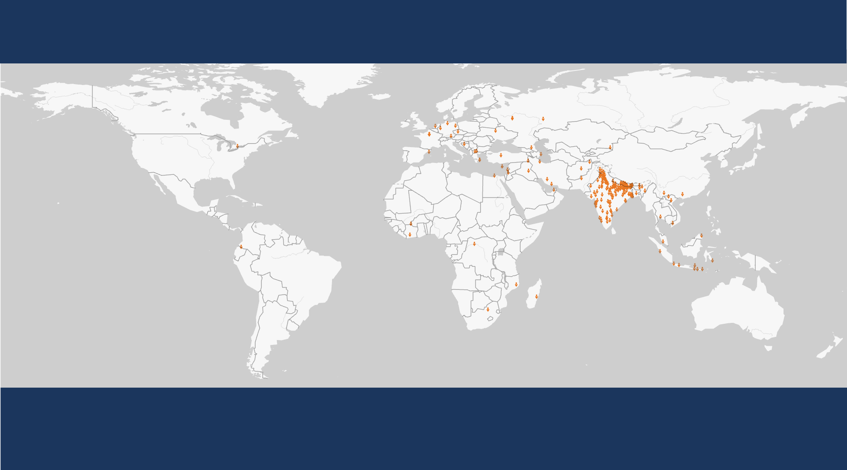
Global Status of Evangelical Christianity
GSEC Status 2
Less than 2 percent evangelical.
Initial or localized church planting within the past two years.
211 people groups with a combined population of 475,154,100 as of January 2023.
Each symbol represents a people group. GSEC values calculated by Global Research, IMB, January 2023. Plate Carrée Projection. Human Geography Basemap by ESRI.
Copyright © 2023 International Mission Board, Global Research
Notes:
211 people groups with a total population of 475,154,100 are classified as GSEC 2 as of January 2023. GSEC 2 people groups are less than 2% evangelical. Initial or localized church planting has been reported within the past two years.

Slide 7
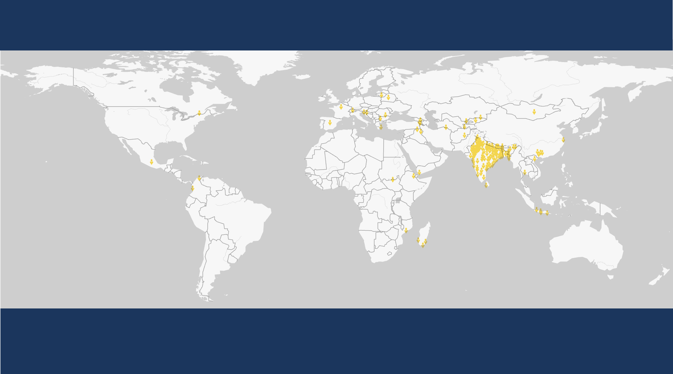
Global Status of Evangelical Christianity
GSEC Status 3
Less than 2 percent evangelical.
Dispersed or widespread church planting within the past two years.
199 people groups with a combined population of 822,807,800 as of January 2023.
Each symbol represents a people group. GSEC values calculated by Global Research, IMB, January 2023. Plate Carrée Projection. Human Geography Basemap by ESRI.
Copyright © 2023 International Mission Board, Global Research
Notes:
199 people groups with a total population of 822,807,800 are classified as GSEC 3 as of January 2023. GSEC 3 people groups are less than 2% evangelical but widespread church planting has been reported within the past two years.

Slide 8
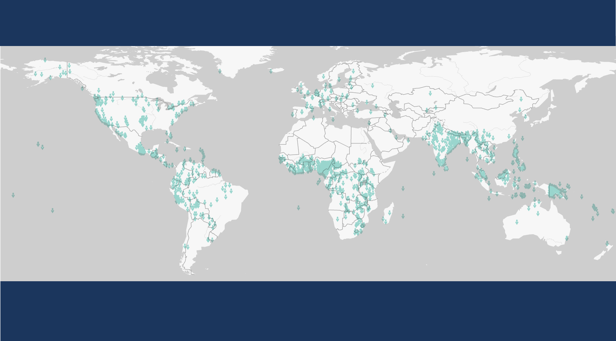
Global Status of Evangelical Christianity
GSEC Status 4
Greater than or equal to 2 percent evangelical.
1,565 people groups with a combined population of 885,819,890 as of January 2023.
Each symbol represents a people group. GSEC values calculated by Global Research, IMB, January 2023. Plate Carrée Projection. Human Geography Basemap by ESRI.
Copyright © 2023 International Mission Board, Global Research
Notes:
1,565 people groups with a total population of 885,819,890 are classified as GSEC 4 as of January 2023. GSEC 4 people groups are greater than or equal to 2% evangelical but less than 5% evangelical.

Slide 9
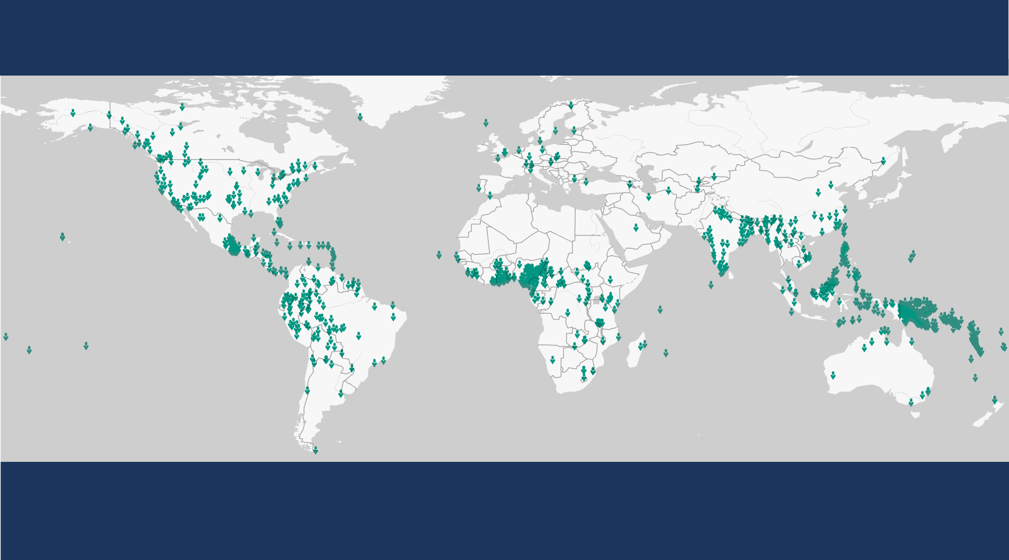
Global Status of Evangelical Christianity
GSEC Status 5
Greater than or equal to 5 percent evangelical.
1,437 people groups with a combined population of 1,808,425,745 as of January 2023.
Each symbol represents a people group. GSEC values calculated by Global Research, IMB, January 2023. Plate Carrée Projection. Human Geography Basemap by ESRI.
Copyright © 2023 International Mission Board, Global Research
Notes:
1,437 people groups with a total population of 1,808,425,745 are classified as GSEC 5 as of January 2023. GSEC 5 people groups are greater than or equal to 5% evangelical but less than 10% evangelical.

Slide 10
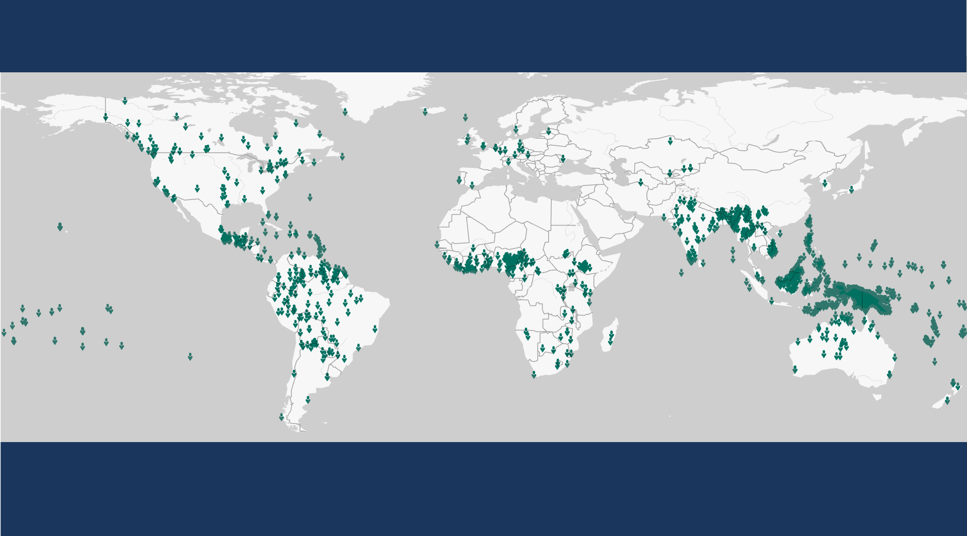
Global Status of Evangelical Christianity
GSEC Status 6
Greater than or equal to 10 percent evangelical.
1,792 people groups with a combined population of 579,940,585 as of January 2023.
Each symbol represents a people group. GSEC values calculated by Global Research, IMB, January 2023. Plate Carrée Projection. Human Geography Basemap by ESRI.
Copyright © 2023 International Mission Board, Global Research
Notes:
1,792 people groups with a total population of 579,940,585 are classified as GSEC 6 as of January 2023. GSEC 6 people groups are greater than or equal to 10% evangelical.

Slide 11
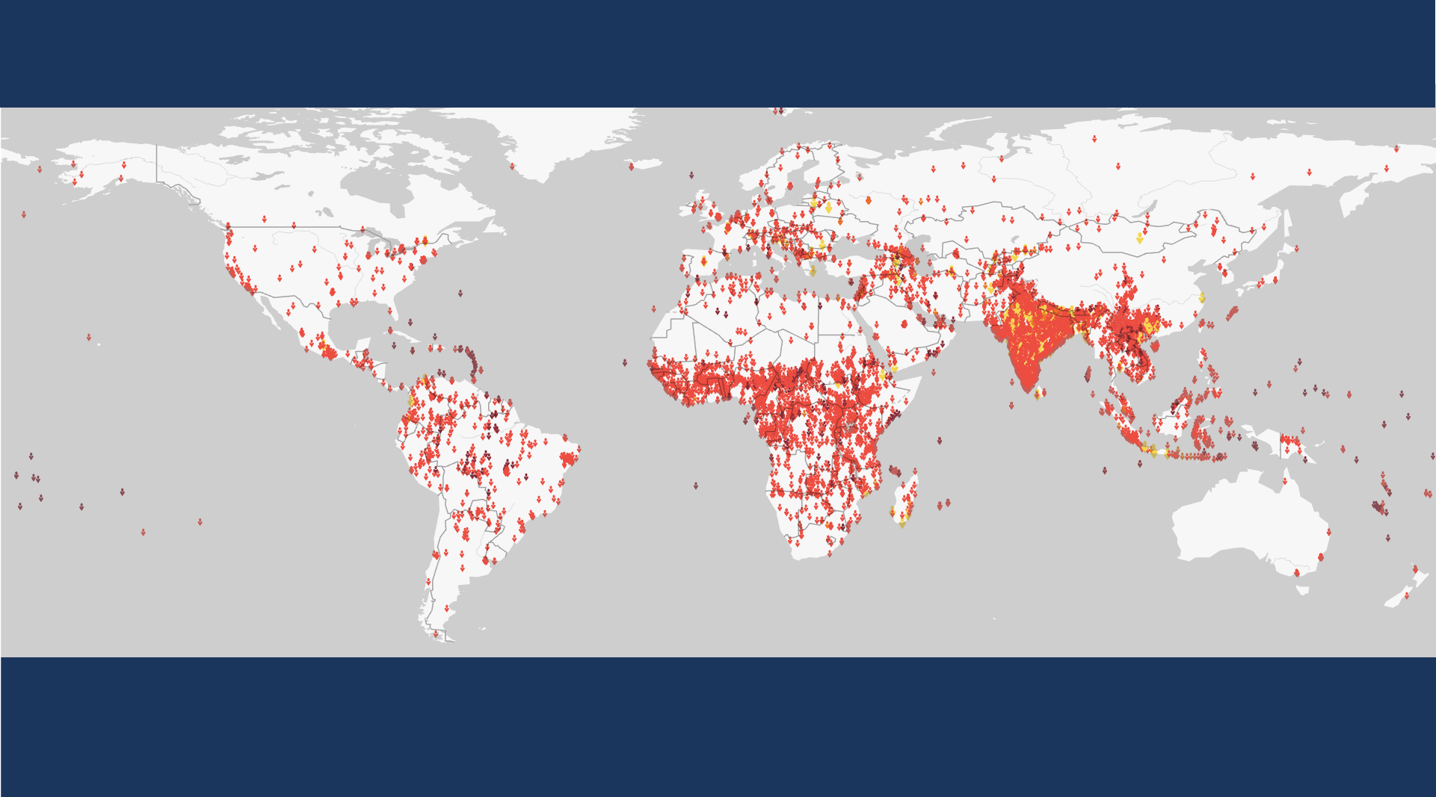
Global Status of Evangelical Christianity
Unreached People Groups
An Unreached People Group (UPG) is a people group with less than 2 percent evangelical Christians.
7,225 people groups with a total population of 4.7 billion are classified as UPGs as of January 2023.
Each symbol represents a people group. GSEC values calculated by Global Research, IMB, January 2023. Plate Carrée Projection. Human Geography Basemap by ESRI.
Copyright © 2023 International Mission Board, Global Research
Notes:
7,225 People Groups with a combined population of 4.7 billion are Unreached as of January 2023. An Unreached People Group (UPG) is a people group among whom evangelical Christians comprise less than 2 percent of the population.

