Slide 1
Affinity Groups
2025 Update
Population Values from 1/1/2025 ArcGIS Service
https://server.maps.imb.org/arcgis/rest/services/YEAR
Notes:
IMB work around the world is organized by Affinity Groups. Affinity Groups are collections of people who share a sense of kinship based on language, religion, culture, or history. They are usually indigenous to a geographic region.

Slide 2
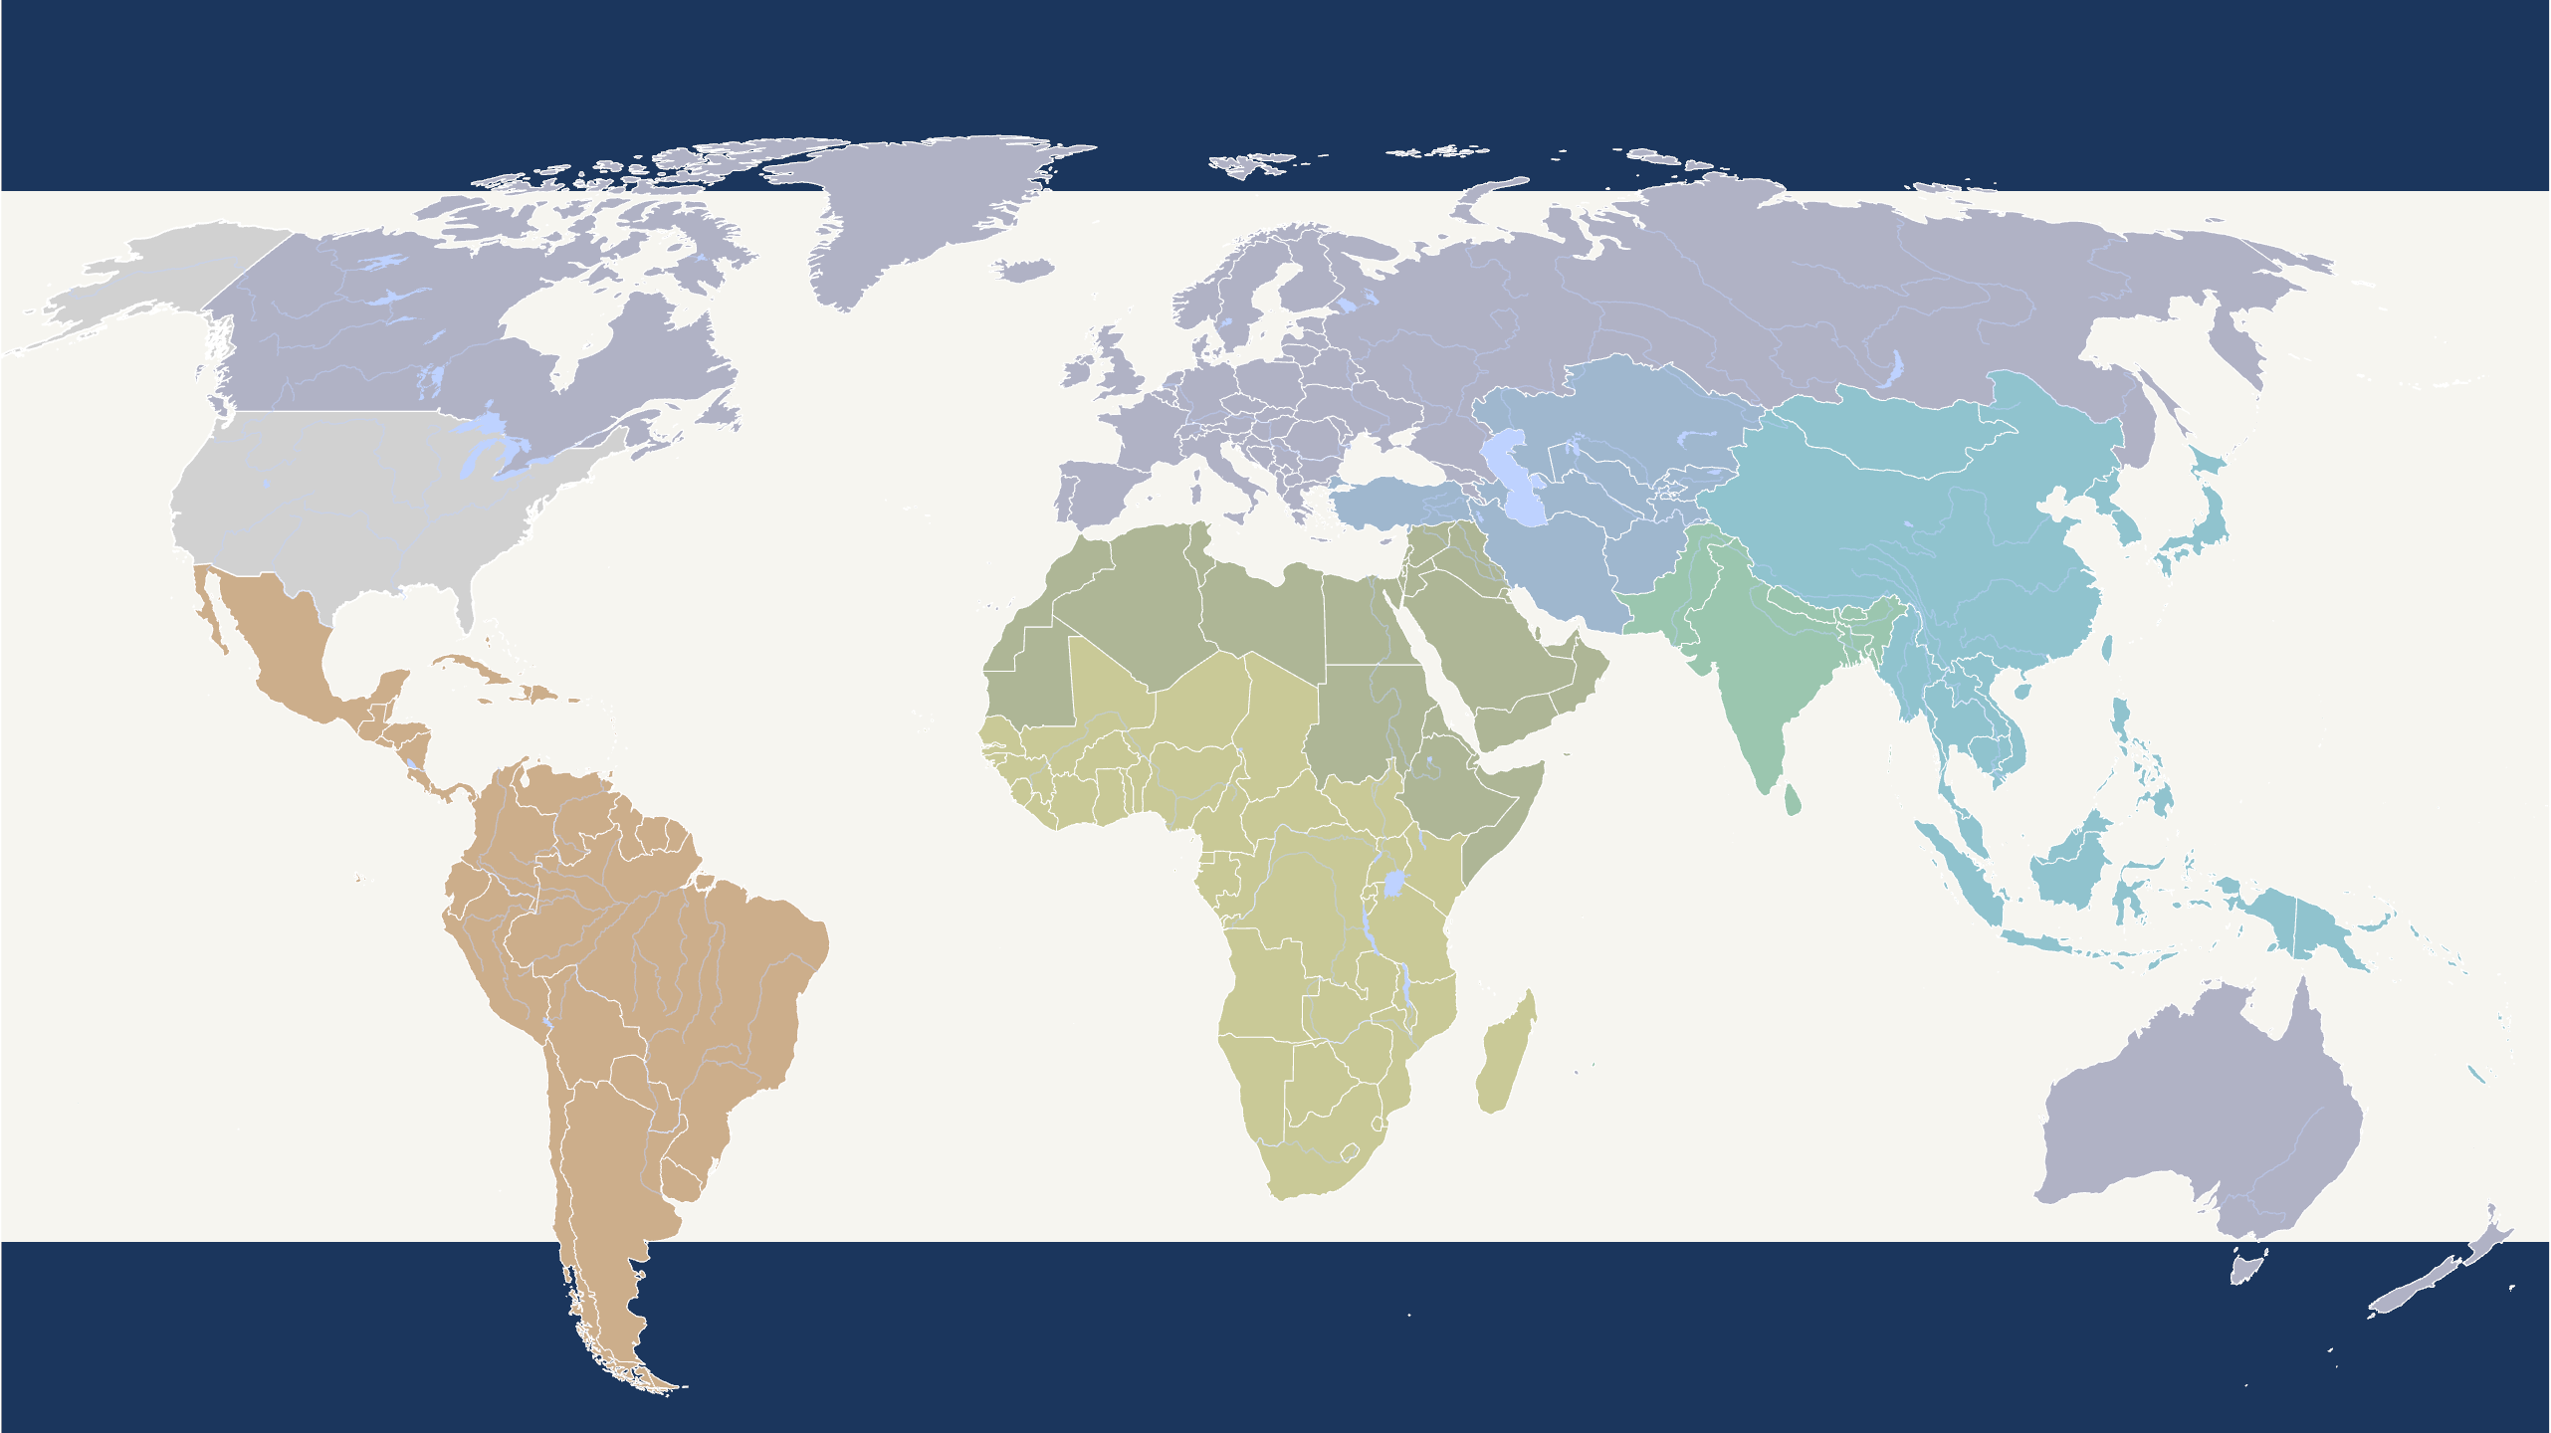
Global Realities – Population: Dying Daily apart from Christ
European Peoples
Population: 783,075,330
Dying Daily: 16,502
Deaf Peoples
Population: 754,994,340
Dying Daily: 1,593
Central Asian Peoples
Population: 388,742,150
Dying Daily: 8,279
Northern African and
Middle Eastern Peoples
Population: 621,113,575
Dying Daily: 13,055
Asian Pacific Rim Peoples
Population: 2,344,647,135
Dying Daily: 47,860
South Asian Peoples
Population: 1,921,744,560
Dying Daily: 40,457
8,094,290,295
GLOBAL POPULATION
166,338
DYING DAILY APART
American Peoples
Population: 651,486,605
Dying Daily: 17,708
Sub-Saharan African Peoples
Population: 1,016,087,785
Dying Daily: 20,885
Notes:
Global Population as of January 1, 2025 was estimated at 8,094,290.295. That is the sum of population for the 12,263 people groups identified in IMB’s peoplegroups.org database.
The harsh global reality is that 166,338 people are dying daily apart from Christ.

Slide 3
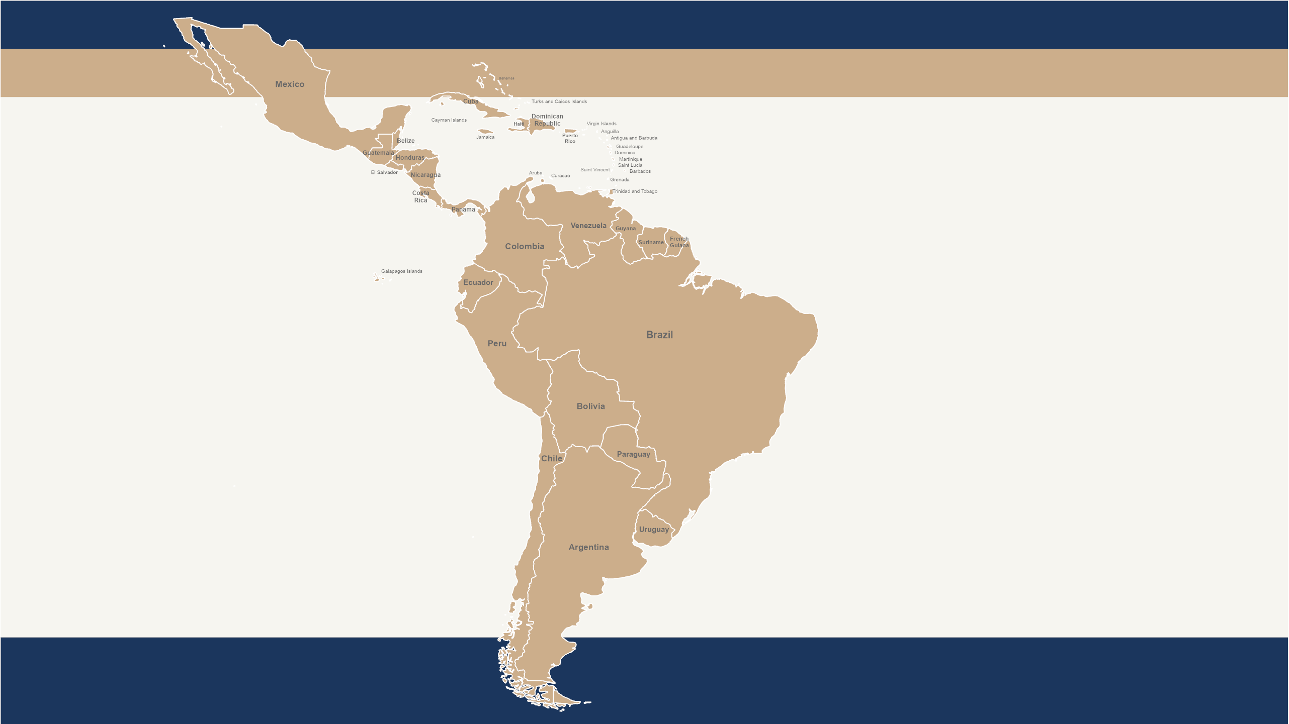

American Peoples
American Peoples
652 million people
12,324 are Dying Daily without Christ
People Group, Population, and Dying Daily estimates are as of 1/1/2025
Copyright © 2025 IMB, Global Research
Notes:
The American peoples have a rich heritage of missions, yet nearly 900 million are living without Jesus. Most of these people live in majority Catholic countries. Thirteen of the 100 most populous cities in the world are found in the Americas, yet one of the greatest challenges is the large number of micro-peoples—small, isolated, indigenous groups with little to no contact with the outside world.
There are 1,381 People Groups assigned to the American Peoples affinity. The slide totals remove United States people groups, which distort both the population and evangelical presence as the US accounts for 276 people groups and 292 million people with 65 million evangelicals.
Dying Daily for AMP is 17,708 if the United States is included. If the United States is excluded, the number is 12,324.

Slide 4
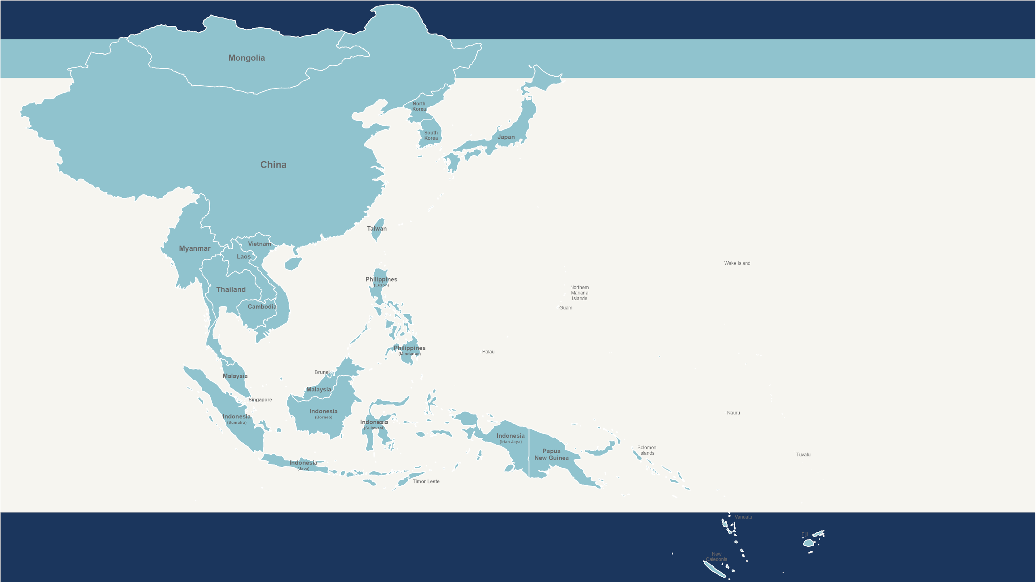
Asian Pacific Rim Peoples
Asian Pacific Rim Peoples
2.34 billion people
47,860 are Dying Daily without Christ
People Group, Population, and Dying Daily estimates are as of 1/1/2025
Copyright © 2025 IMB, Global Research
Notes:
The Asia-Pacific rim encompasses 2.34 billion people, concentrated in 41 countries ranging from densely populated China and Indonesia to sparsely populated and remote island nations. A majority of the world’s Buddhists live in this part of Asia; only 4.2% of people in the Asia-Pacific rim are followers of Jesus. More than half of the world’s largest cities are found within this affinity.

Slide 5
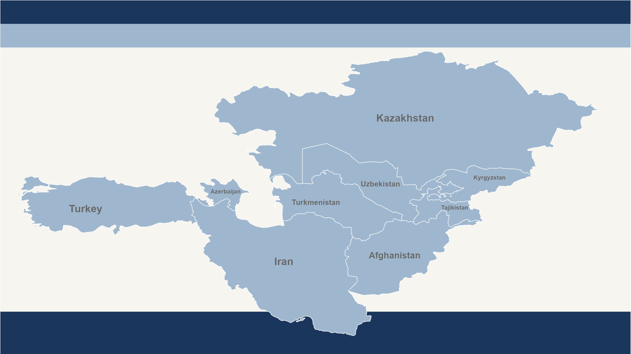
Central Asian Peoples
Central Asian Peoples
389 million people
8,279 are Dying Daily without Christ
People Group, Population, and Dying Daily estimates are as of 1/1/2025
Copyright © 2025 IMB, Global Research
Notes:
Almost all the Persian and Turkic people who call Central Asia home are unreached. Most Central Asians have no knowledge of biblical Christianity and are unaware that the gospel is good news. Most the countries within Central Asia are either Islamic states—governed by Sharia law—or secular states with Islam defined as the state religion.

Slide 6
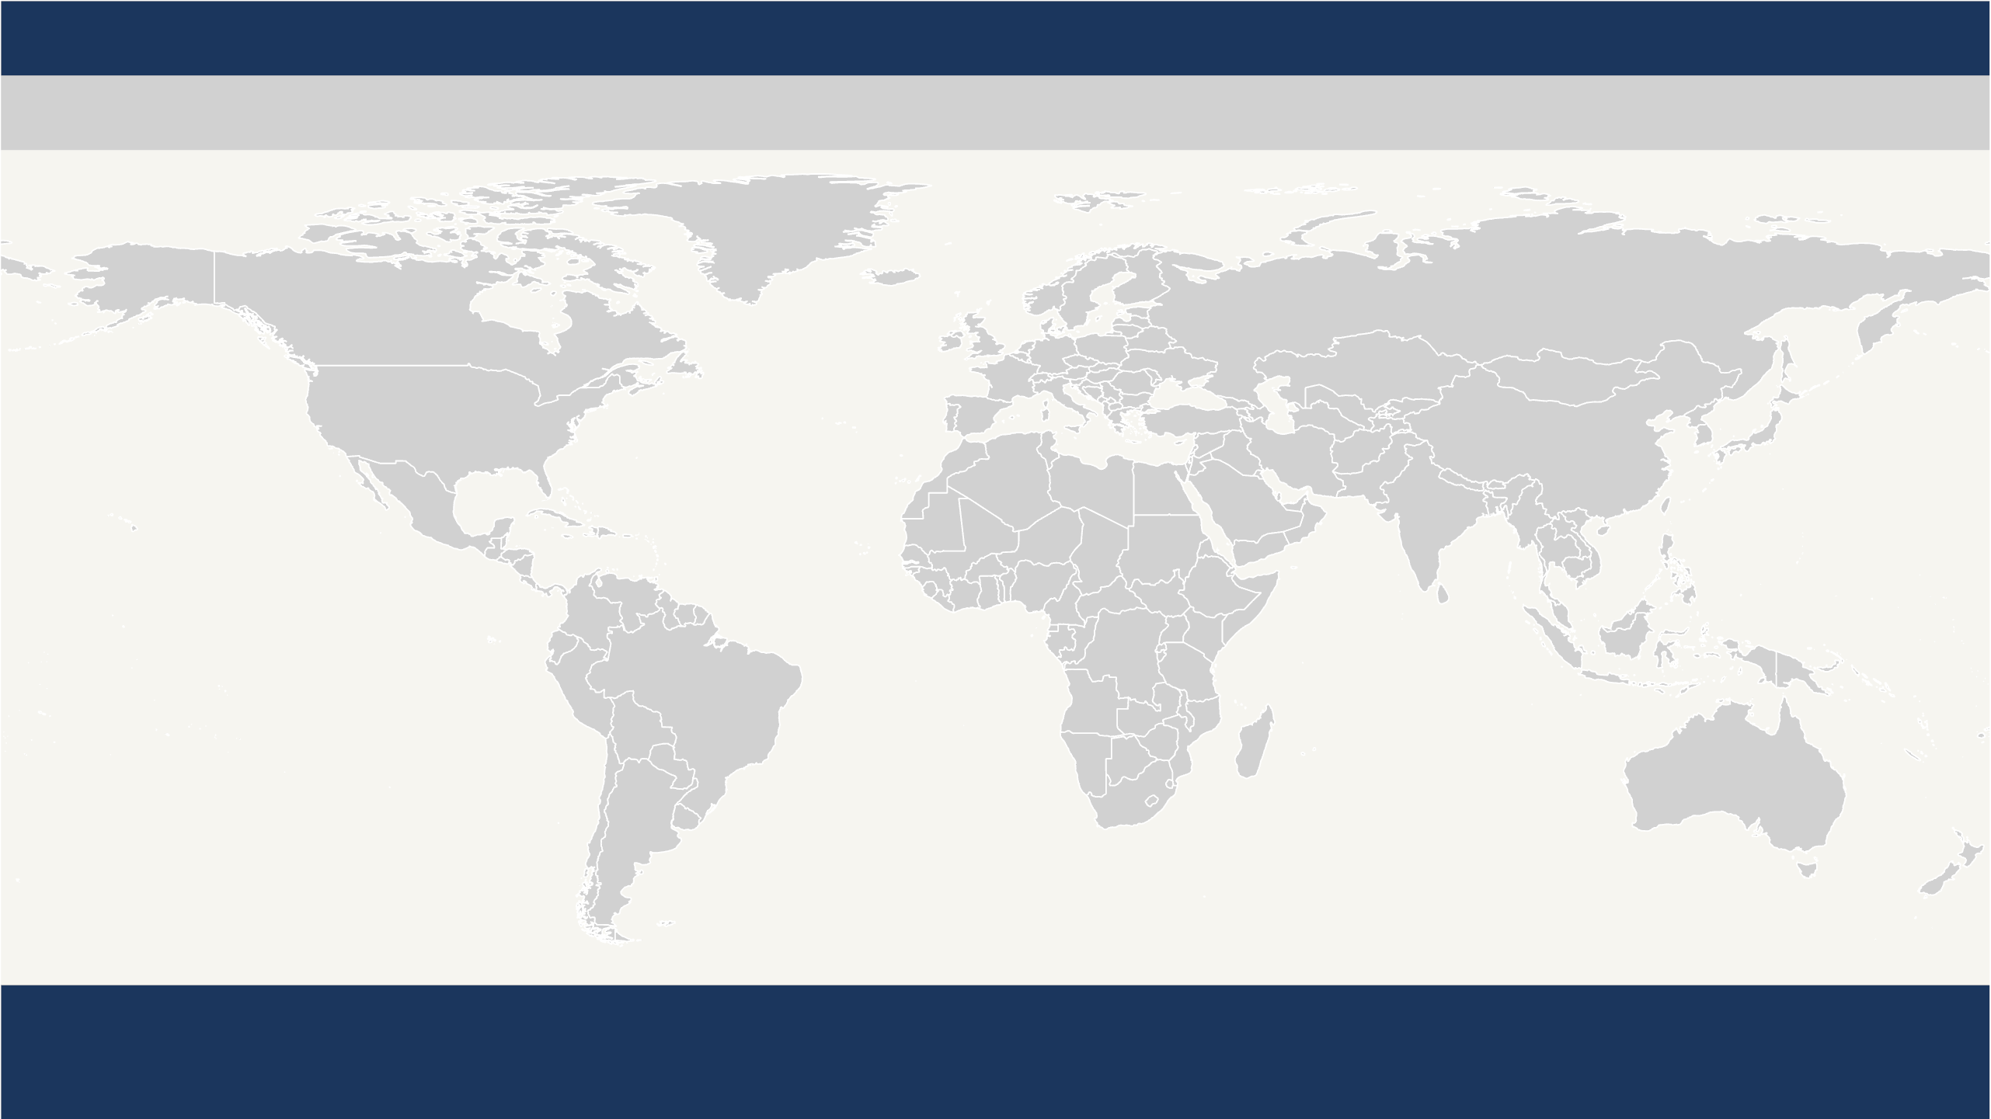
Deaf Peoples
Deaf Peoples
75 million people
1,593 are Dying Daily without Christ
People Group, Population, and Dying Daily estimates are as of 1/1/2025
Copyright © 2025 IMB, Global Research
Notes:
Most of the 75 million deaf people around the world have never seen Jesus’ name signed in their language. Often ignored and oppressed, the deaf are some of the least evangelized people on earth. Although there are 300 different sign languages, many are connected by similarities called sign roots—common facial expressions, body movements, and hand signs. IMB missionaries are using sign roots to translate Bible stories into the most widely used sign languages.

Slide 7
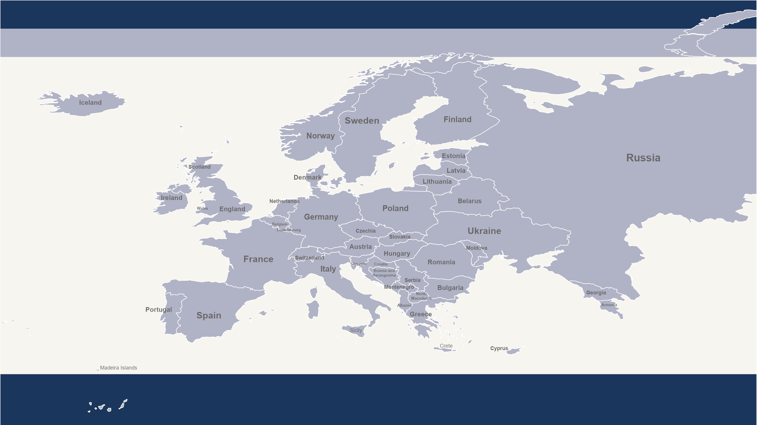
European Peoples
European Peoples
783 million people
16,502 are Dying Daily without Christ
People Group, Population, and Dying Daily estimates are as of 1/1/2025
Copyright © 2025 IMB, Global Research
Notes:
Europe is known for its history, architecture, and art. But what most people don’t know about Europe is the deep need for the gospel. Less than 1.1% of Europeans are evangelical Christians. Believers in Europe have the God-given task of sharing the gospel with the 98.9% who do not yet know Jesus. Your IMB missionaries work alongside local churches, seminaries, and individual believers to train and equip Christians in Europe to share the gospel and form new churches.

Slide 8
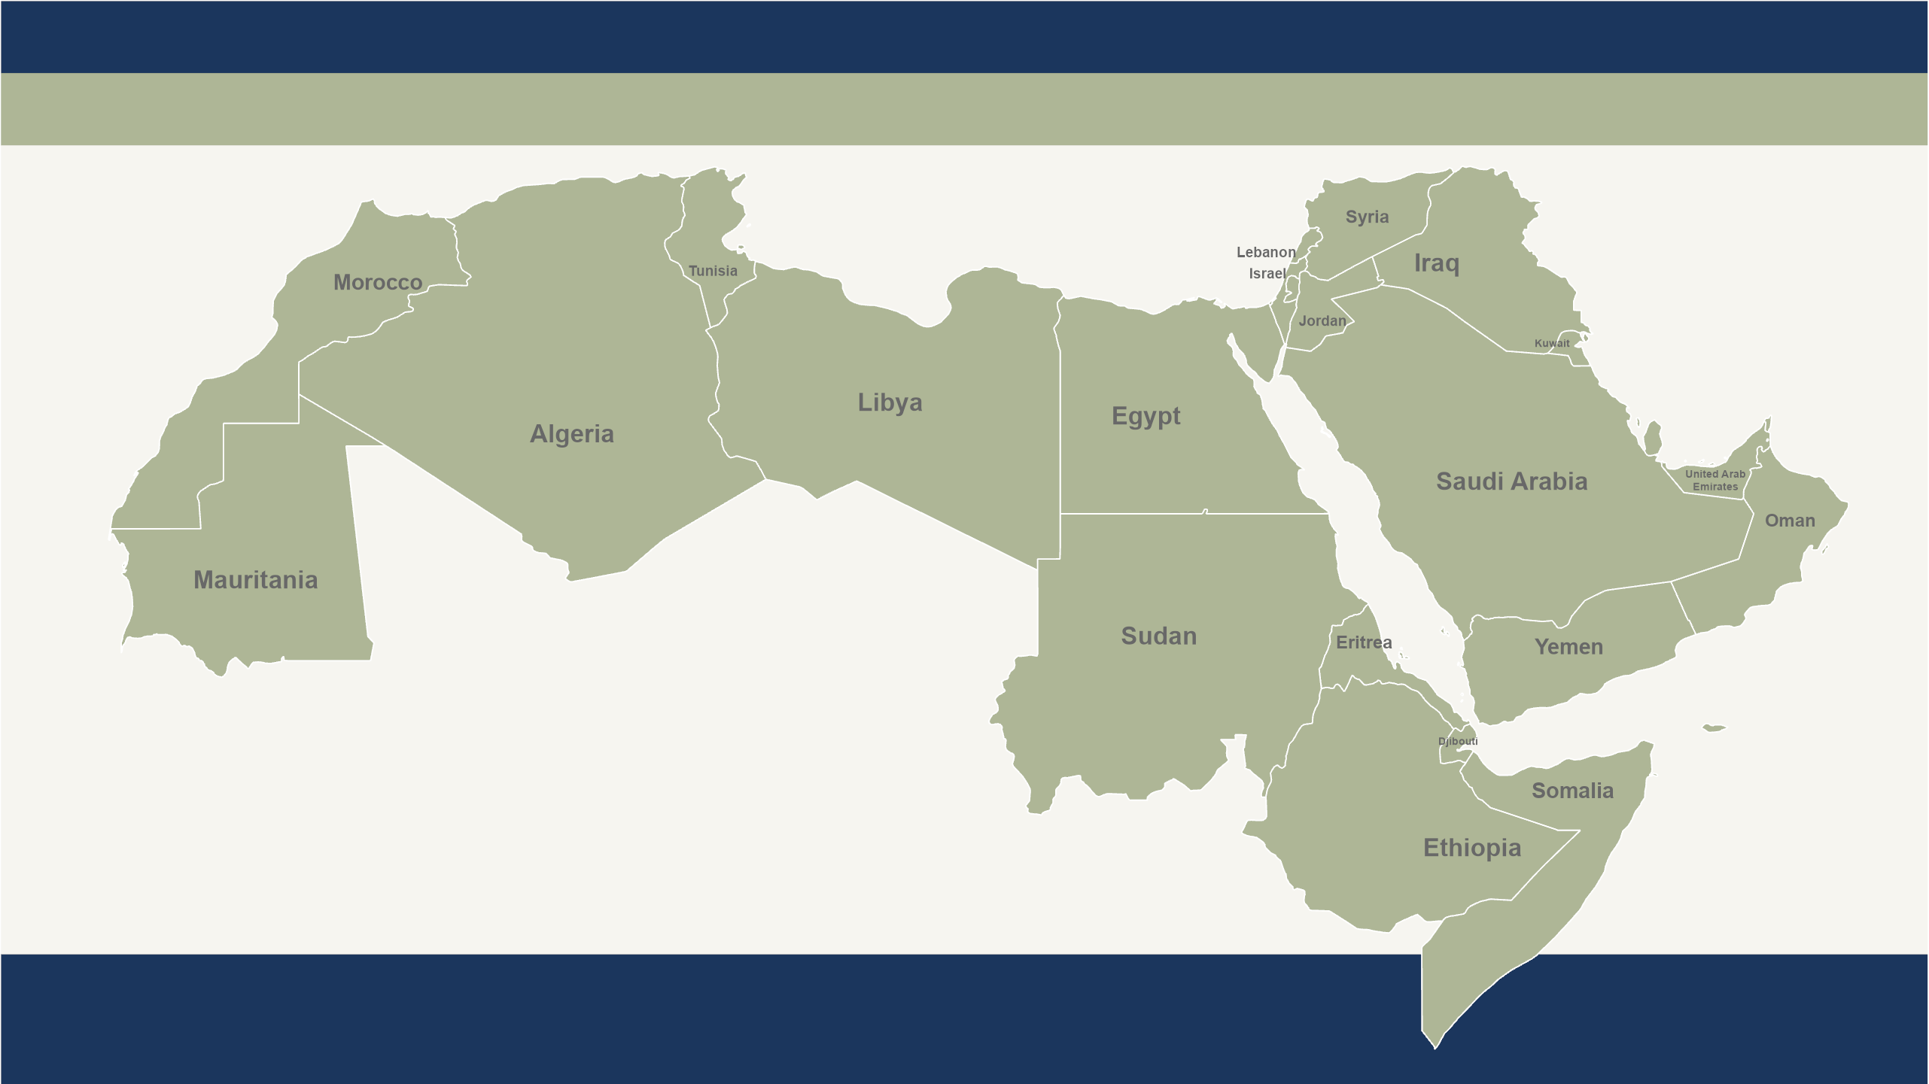
Northern African and Middle Eastern Peoples
Northern African and Middle Eastern Peoples
621 million people
13,055 are Dying Daily without Christ
People Group, Population, and Dying Daily estimates are as of 1/1/2025
Copyright © 2025 IMB, Global Research
Notes:
Northern African and Middle Eastern peoples live in a place where history blends with the modern world. The birthplace of Judaism, Christianity and Islam—the Abrahamic religions—daily life is dominated by Islam. A region of princes and paupers, here the church is engaged in a captivating resurgence unlike any other.

Slide 9
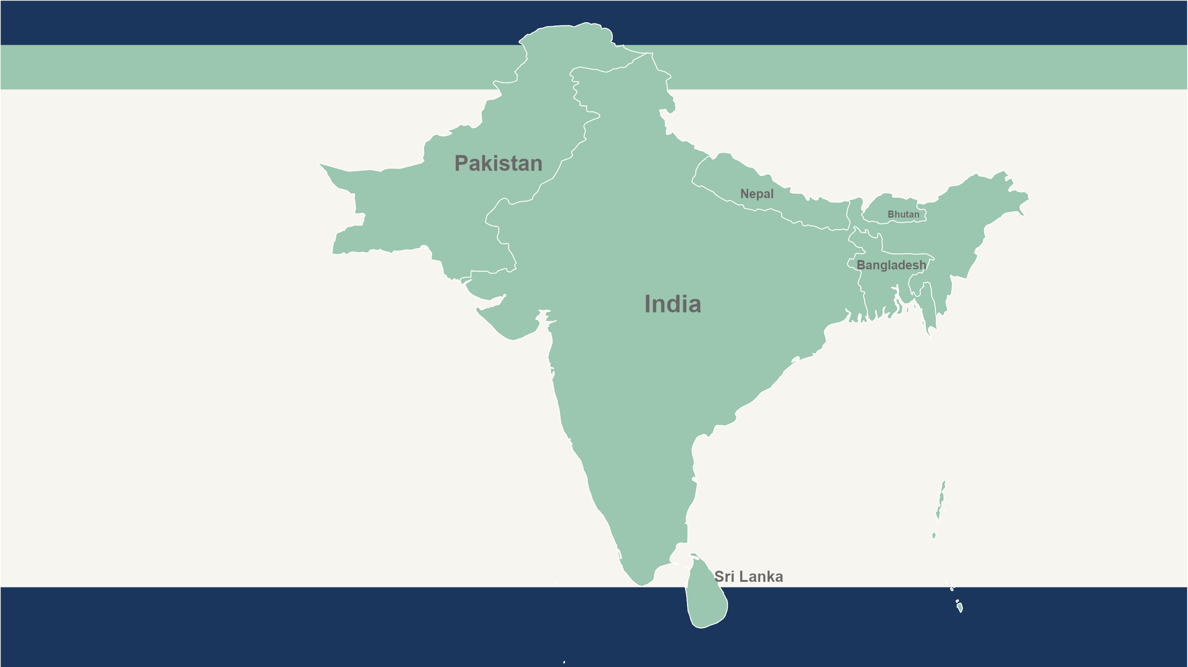
South Asian Peoples
South Asian Peoples
1.9 billion people
40,457 are Dying Daily without Christ
People Group, Population, and Dying Daily estimates are as of 1/1/2025
Copyright © 2025 IMB, Global Research
Notes:
From the heights of the mighty Himalayas to the crystal-clear water of the Maldives, South Asia is both awe-inspiring and heart-wrenching. It has the largest concentration of non-Christians on the planet. South Asia is home to more than 500 million Muslims and is the birthplace of Hinduism, Buddhism, Sikhism, and Jainism. The 1.9 billion people of South Asia are concentrated in an area less than half the size of the USA.

Slide 10
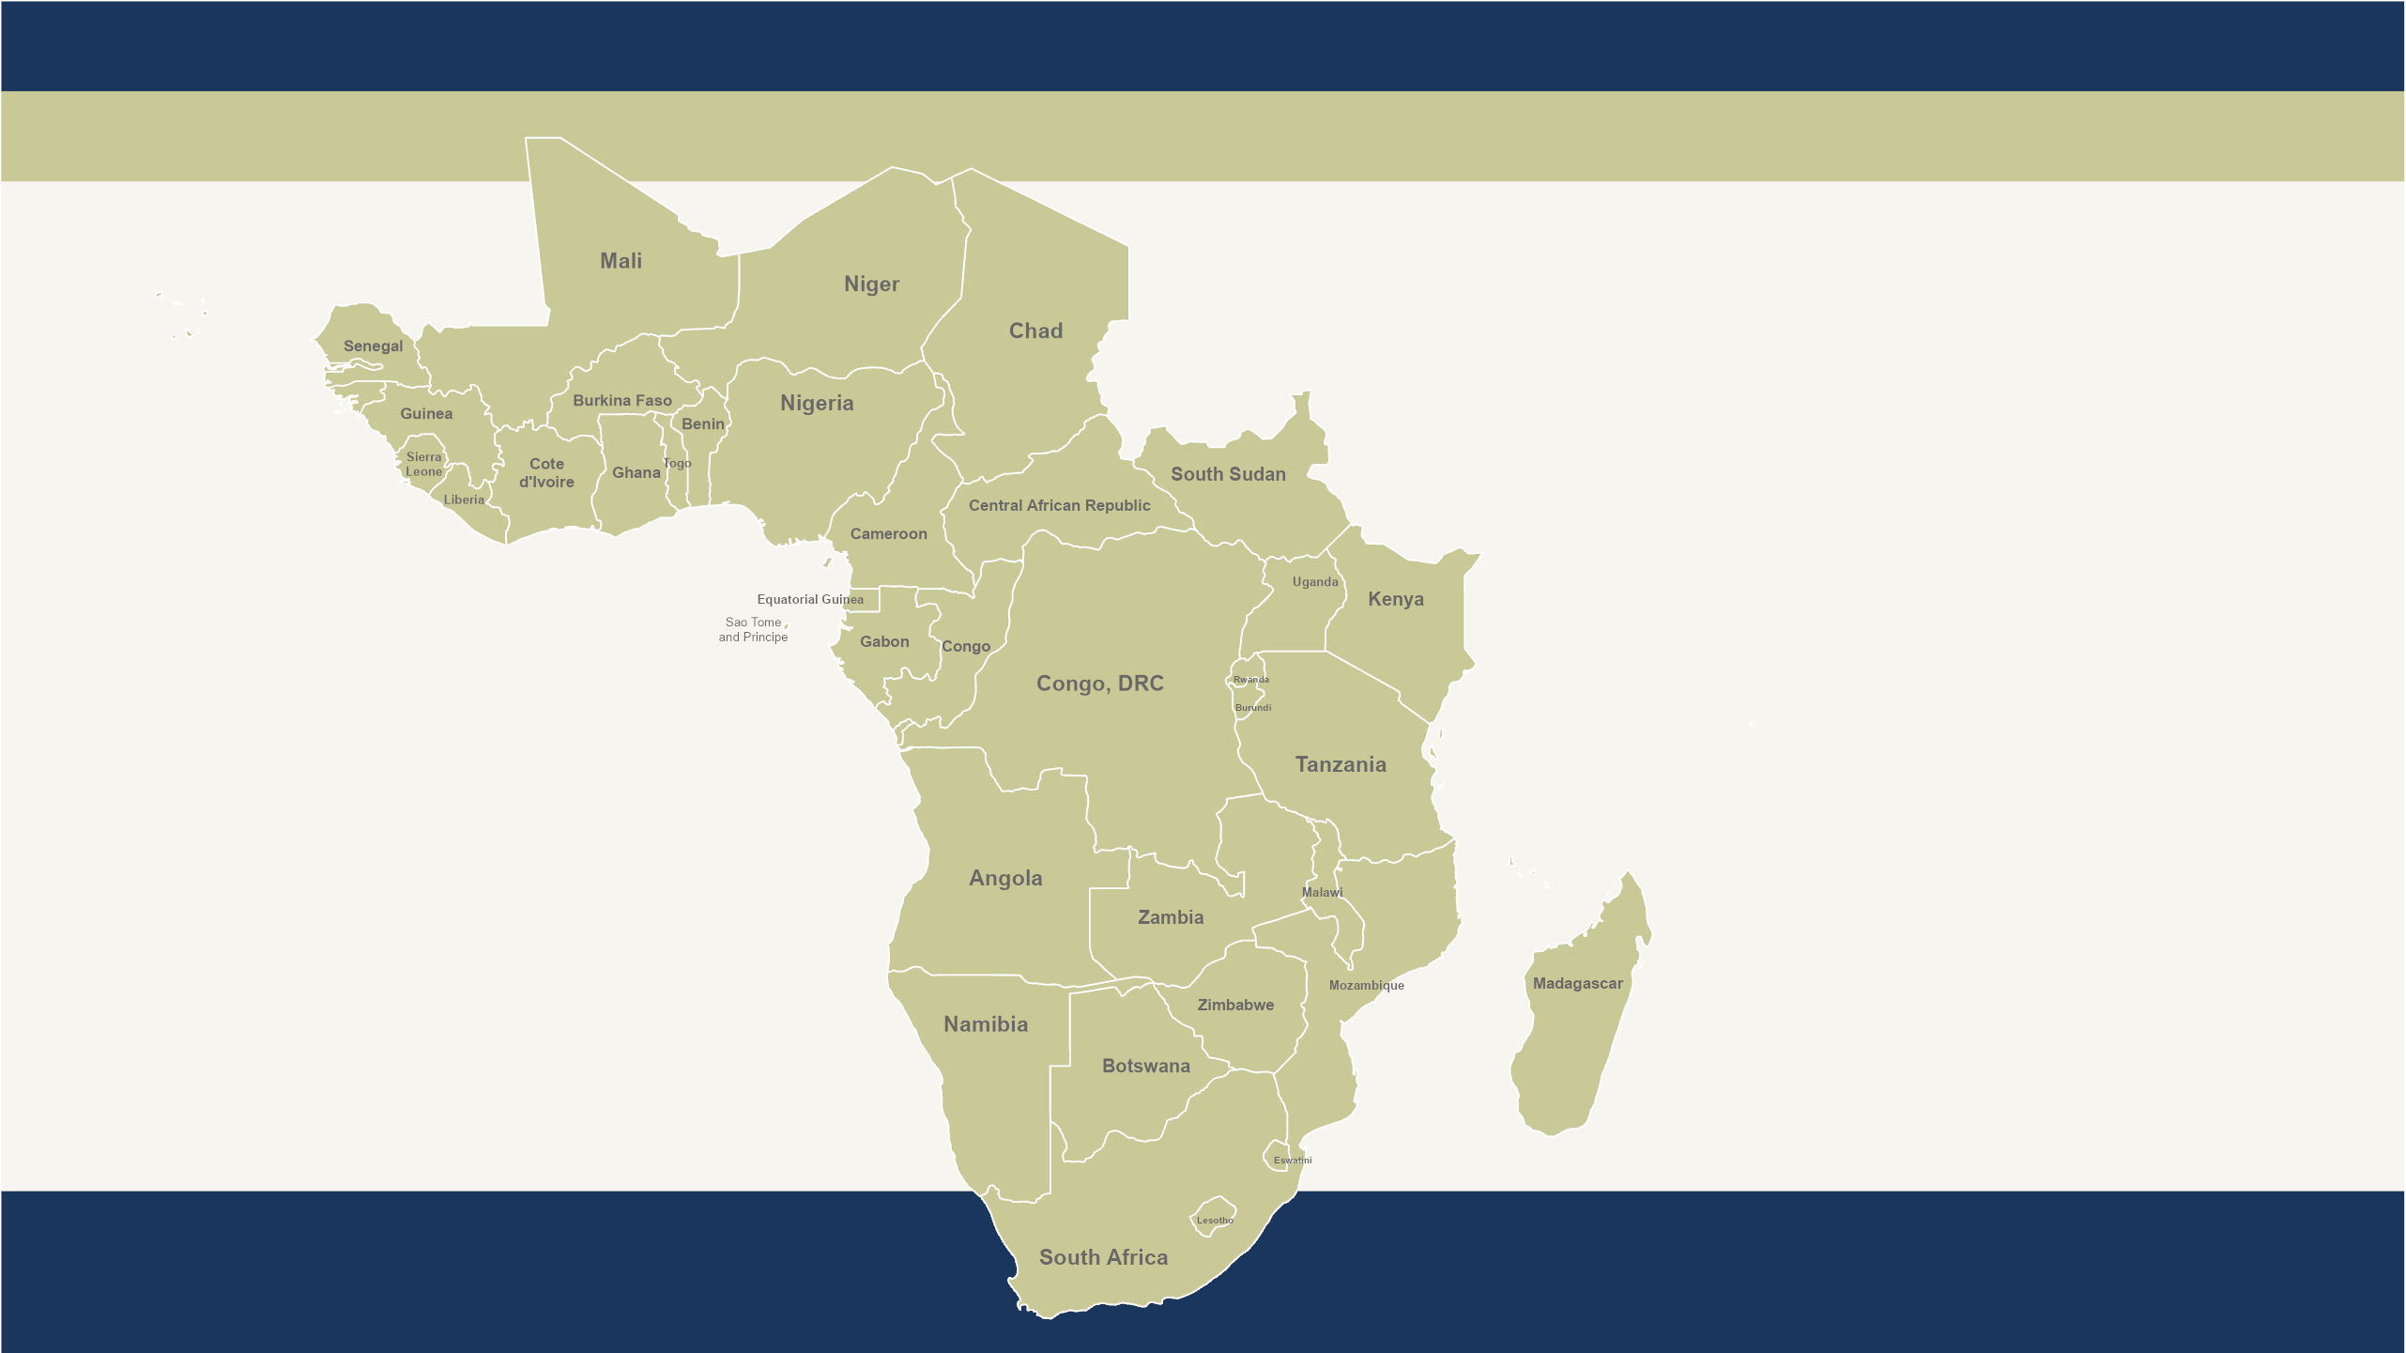
Sub-Saharan African Peoples
Sub-Saharan African Peoples
1 billion people
20,885 are Dying Daily without Christ
People Group, Population, and Dying Daily estimates are as of 1/1/2025
Copyright © 2025 IMB, Global Research
Notes:
Sub-Saharan African peoples have a growing Christian population, yet nearly 1,600 unreached people groups remain in sprawling cities, barren deserts, rain forests, and tropical islands. Currently 41% urban, by most estimates Africa will be 60% urban by the year 2050.

