Slide 1
Global Status of Evangelical Christianity 2024 Update
Data Values from 1/1/2024 ArcGIS Service
https://gis.imb.org/arcgis/rest/services/YEAR
Explore an Interactive version of the latest GSEC Map.

Slide 2
Global Status of Evangelical Christianity
The Global Status of Evangelical Christianity (GSEC) map portrays the spread of the gospel among people groups by measuring:
percentage of evangelicals;
access to evangelical print, audio, visual, or human resources;
recent church planting activity.
The GSEC model provides critical information for strategic decision makers.
Learn more at: peoplegroups.org
Status | Description
0 | No evangelical Christians or churches. No access to evangelical print, audio, visual or human resources.
1 | Less than 2 percent evangelical. Some evangelical resources available. No active church planting within the past two years.
2 | Less than 2 percent evangelical. Initial or localized church planting within the past two years.
3 | Less than 2 percent evangelical. Dispersed or widespread church planting within the past two years.
4 | Greater than or equal to 2 percent evangelical.
5 | Greater than or equal to 5 percent evangelical.
6 | Greater than or equal to 10 percent evangelical.
Notes:
The Global Status of Evangelical Christianity helps us understand how the gospel spreads among people groups by comparing the percentage of evangelicals, the availability of evangelical resources, and reports of recent church planting activity for each people group.

Slide 3
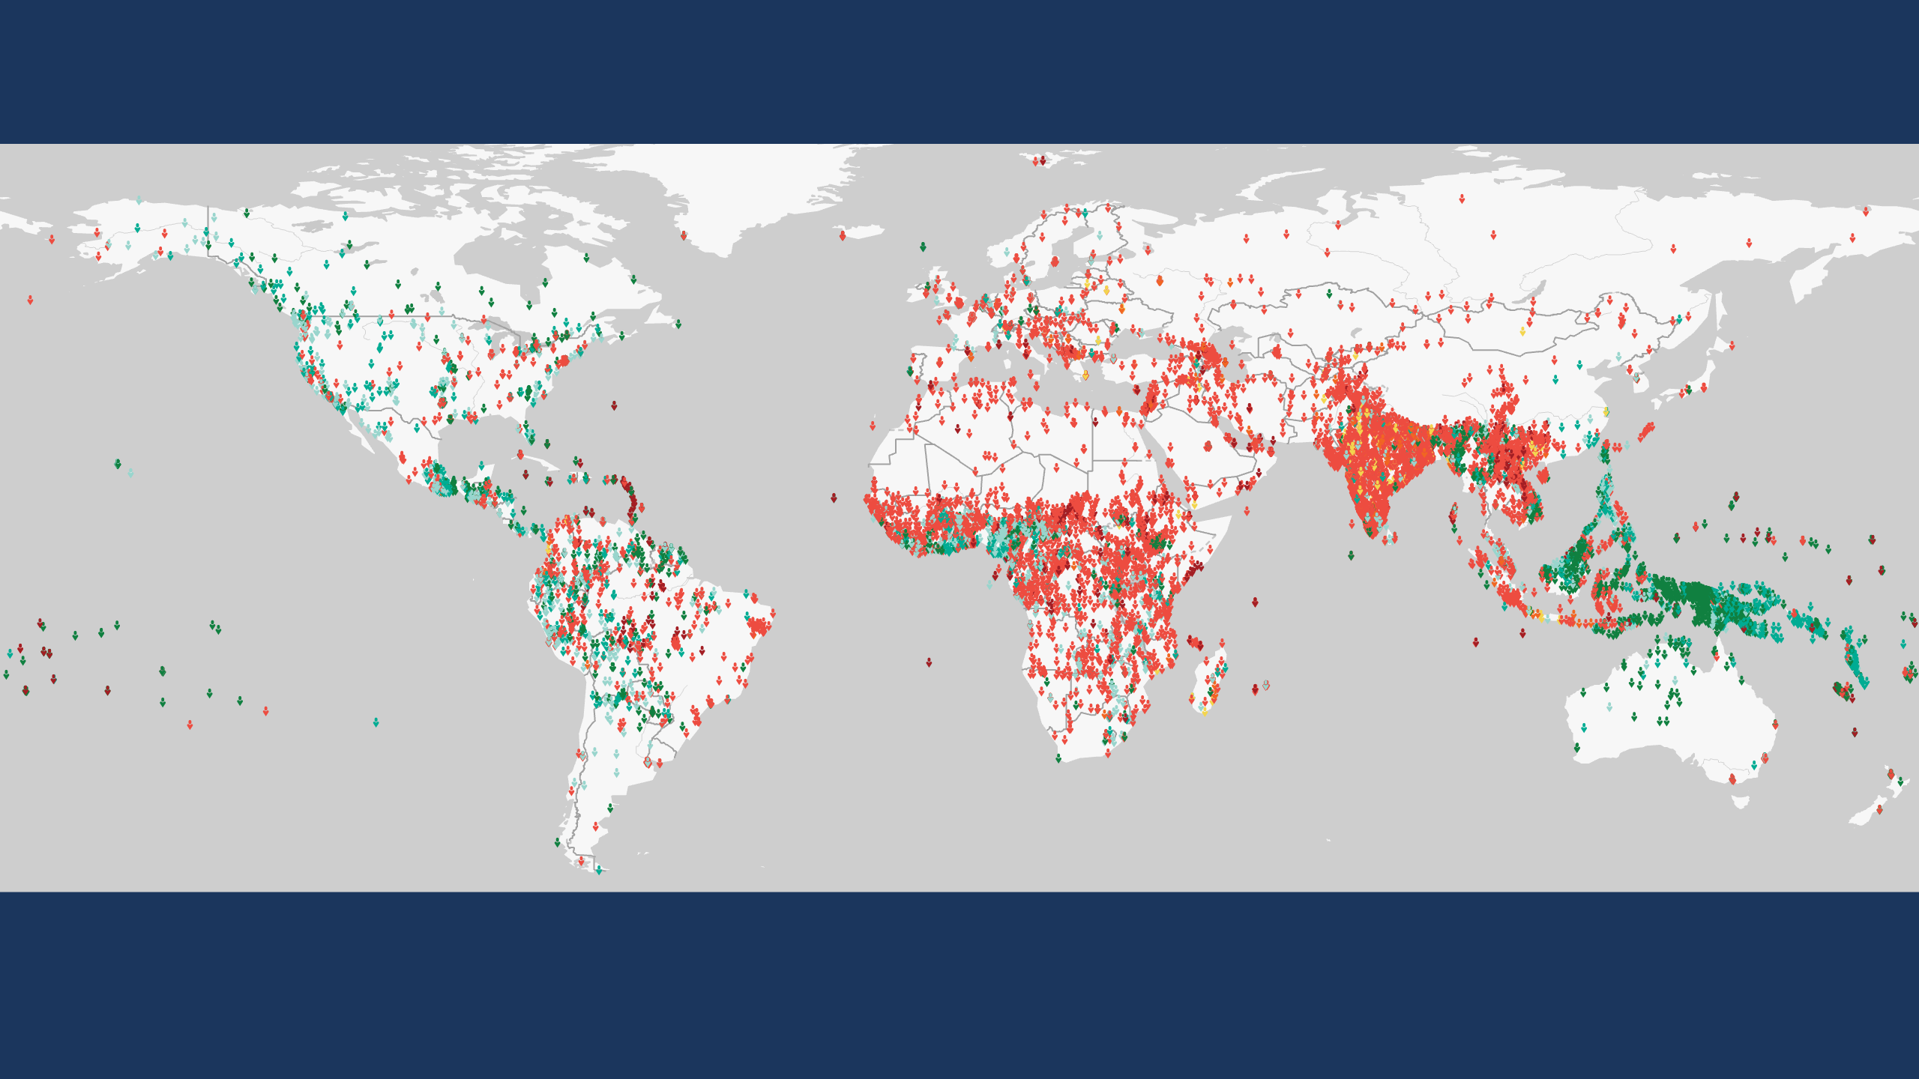
Global Status of Evangelical Christianity
12,114 people groups with a combined population of 8 billion
are included in the IMB database as of January 2024.
Each symbol represents one people group. GSEC values calculated by Global Research, IMB, January 2024. Plate Carrée Projection. Human Geography Basemap by ESRI 2023.
Copyright © 2024 International Mission Board, Global Research
Notes:
12,114 people groups with a combined population of 8 billion (8,034,973,685) are included in the IMB database as of January 2024. Each people group is represented by a single symbol.

Slide 4
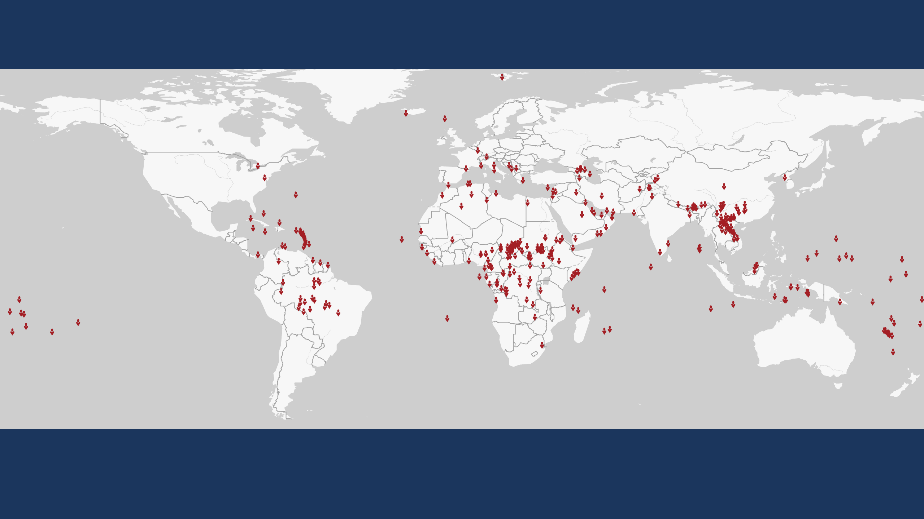
Global Status of Evangelical Christianity
GSEC Status 0
No evangelical Christians or churches.
No access to evangelical print, audio, visual or human resources.
336 people groups with a combined population of 11,936,535 as of January 2024.
Each symbol represents one people group. GSEC values calculated by Global Research, IMB, January 2024. Plate Carrée Projection. Human Geography Basemap by ESRI 2023.
Copyright © 2024 International Mission Board, Global Research
Notes:
336 people groups with a total population of 11,936,535 are classified as GSEC 0 as of January 2024. GSEC 0 people groups have no evangelical Christians or churches and no access to evangelical print, audio, visual or human resources.

Slide 5
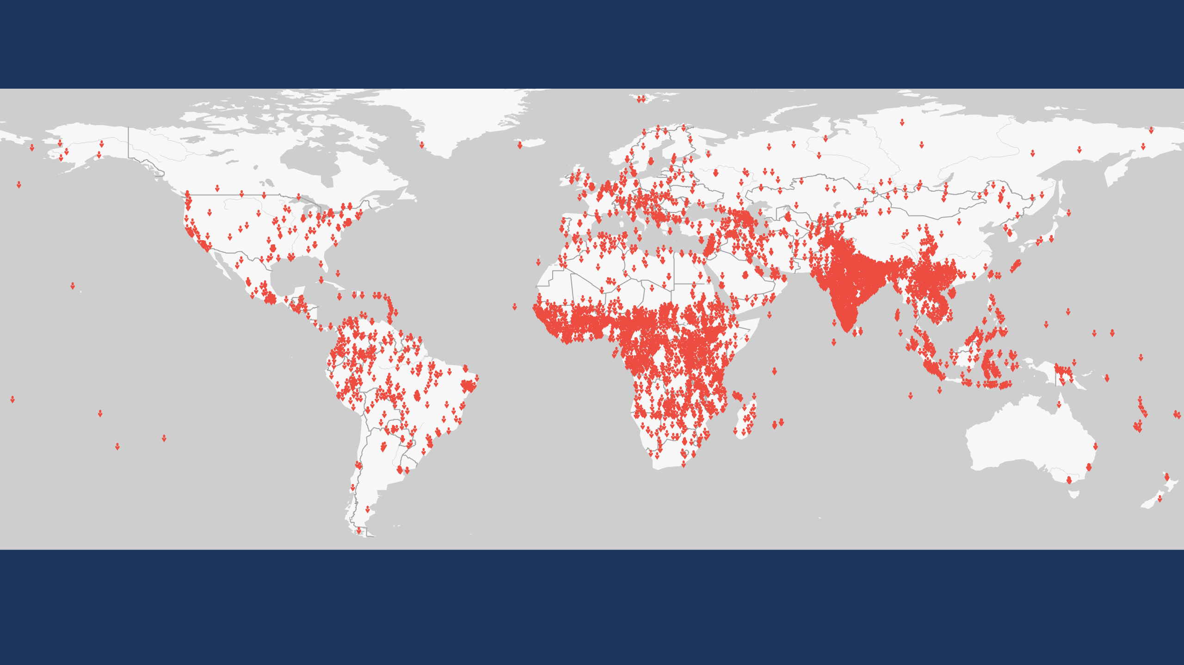
Global Status of Evangelical Christianity
GSEC Status 1
Less than 2 percent evangelical. Some evangelical resources are available.
No active church planting within the past two years.
6,492 people groups with a combined population of 3,374,195,275 as of January 2024.
Each symbol represents one people group. GSEC values calculated by Global Research, IMB, January 2024. Plate Carrée Projection. Human Geography Basemap by ESRI 2023.
Copyright © 2024 International Mission Board, Global Research
Notes:
6,492 people groups with a total population of 3,374,195,275 are classified as GSEC 1 as of January 2024. GSEC 1 people groups are less than 2% evangelical. Some evangelical resources are available in their heart language but there has been no active church planting reported among them within the past two years.

Slide 6
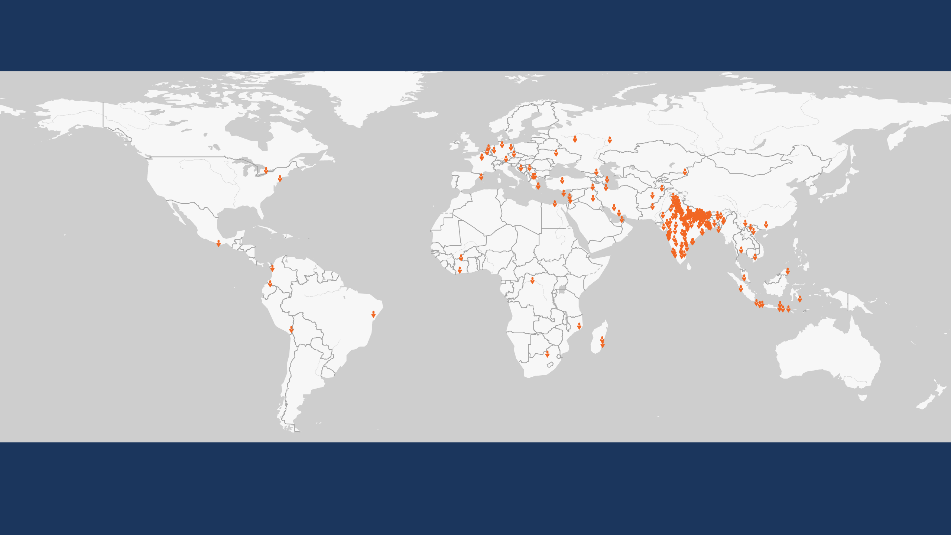
Global Status of Evangelical Christianity
GSEC Status 2
Less than 2 percent evangelical.
Initial or localized church planting within the past two years.
220 people groups with a combined population of 512,236,700 as of January 2024.
Each symbol represents one people group. GSEC values calculated by Global Research, IMB, January 2024. Plate Carrée Projection. Human Geography Basemap by ESRI 2023.
Copyright © 2024 International Mission Board, Global Research
Notes:
220 people groups with a total population of 512,236,700 are classified as GSEC 2 as of January 2024. GSEC 2 people groups are less than 2% evangelical. Initial or localized church planting has been reported within the past two years.

Slide 7
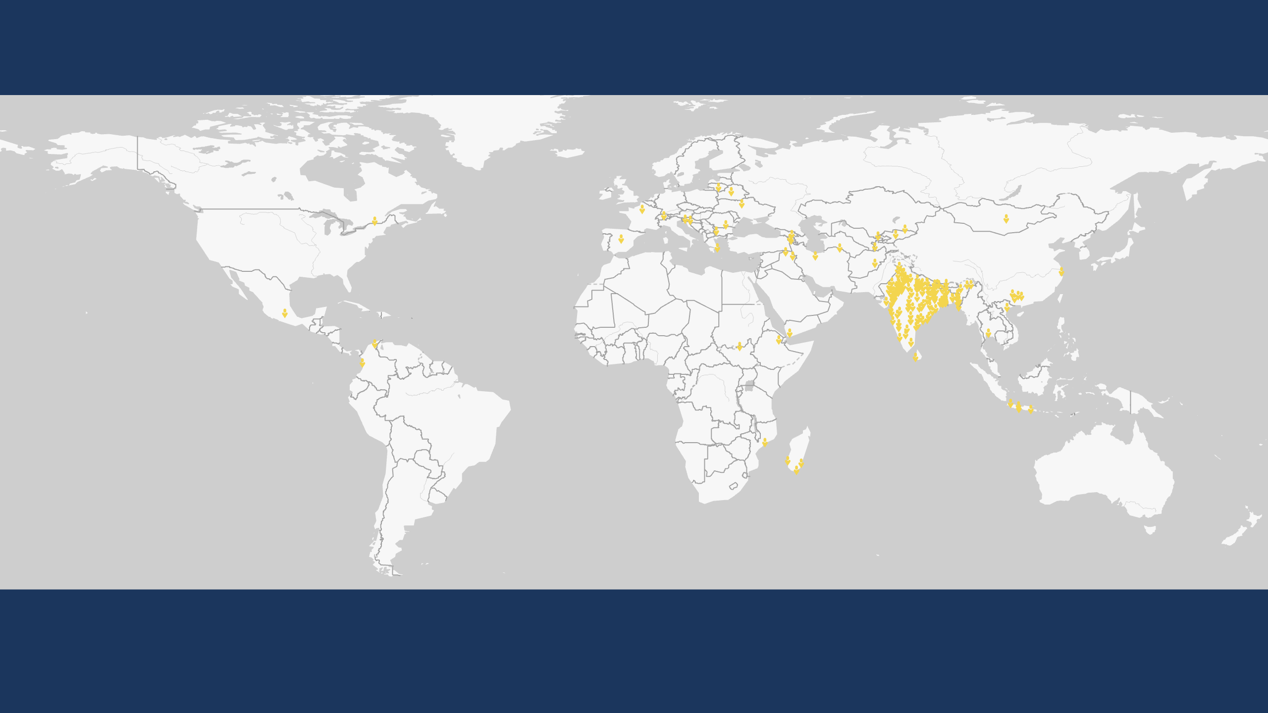
Global Status of Evangelical Christianity
GSEC Status 3
Less than 2 percent evangelical.
Dispersed or widespread church planting within the past two years.
202 people groups with a combined population of 864,863,200 as of January 2024.
Each symbol represents one people group. GSEC values calculated by Global Research, IMB, January 2024. Plate Carrée Projection. Human Geography Basemap by ESRI 2023.
Copyright © 2024 International Mission Board, Global Research
Notes:
202 people groups with a total population of 864,863,200 are classified as GSEC 3 as of January 2024. GSEC 3 people groups are less than 2% evangelical but widespread church planting has been reported within the past two years.

Slide 8
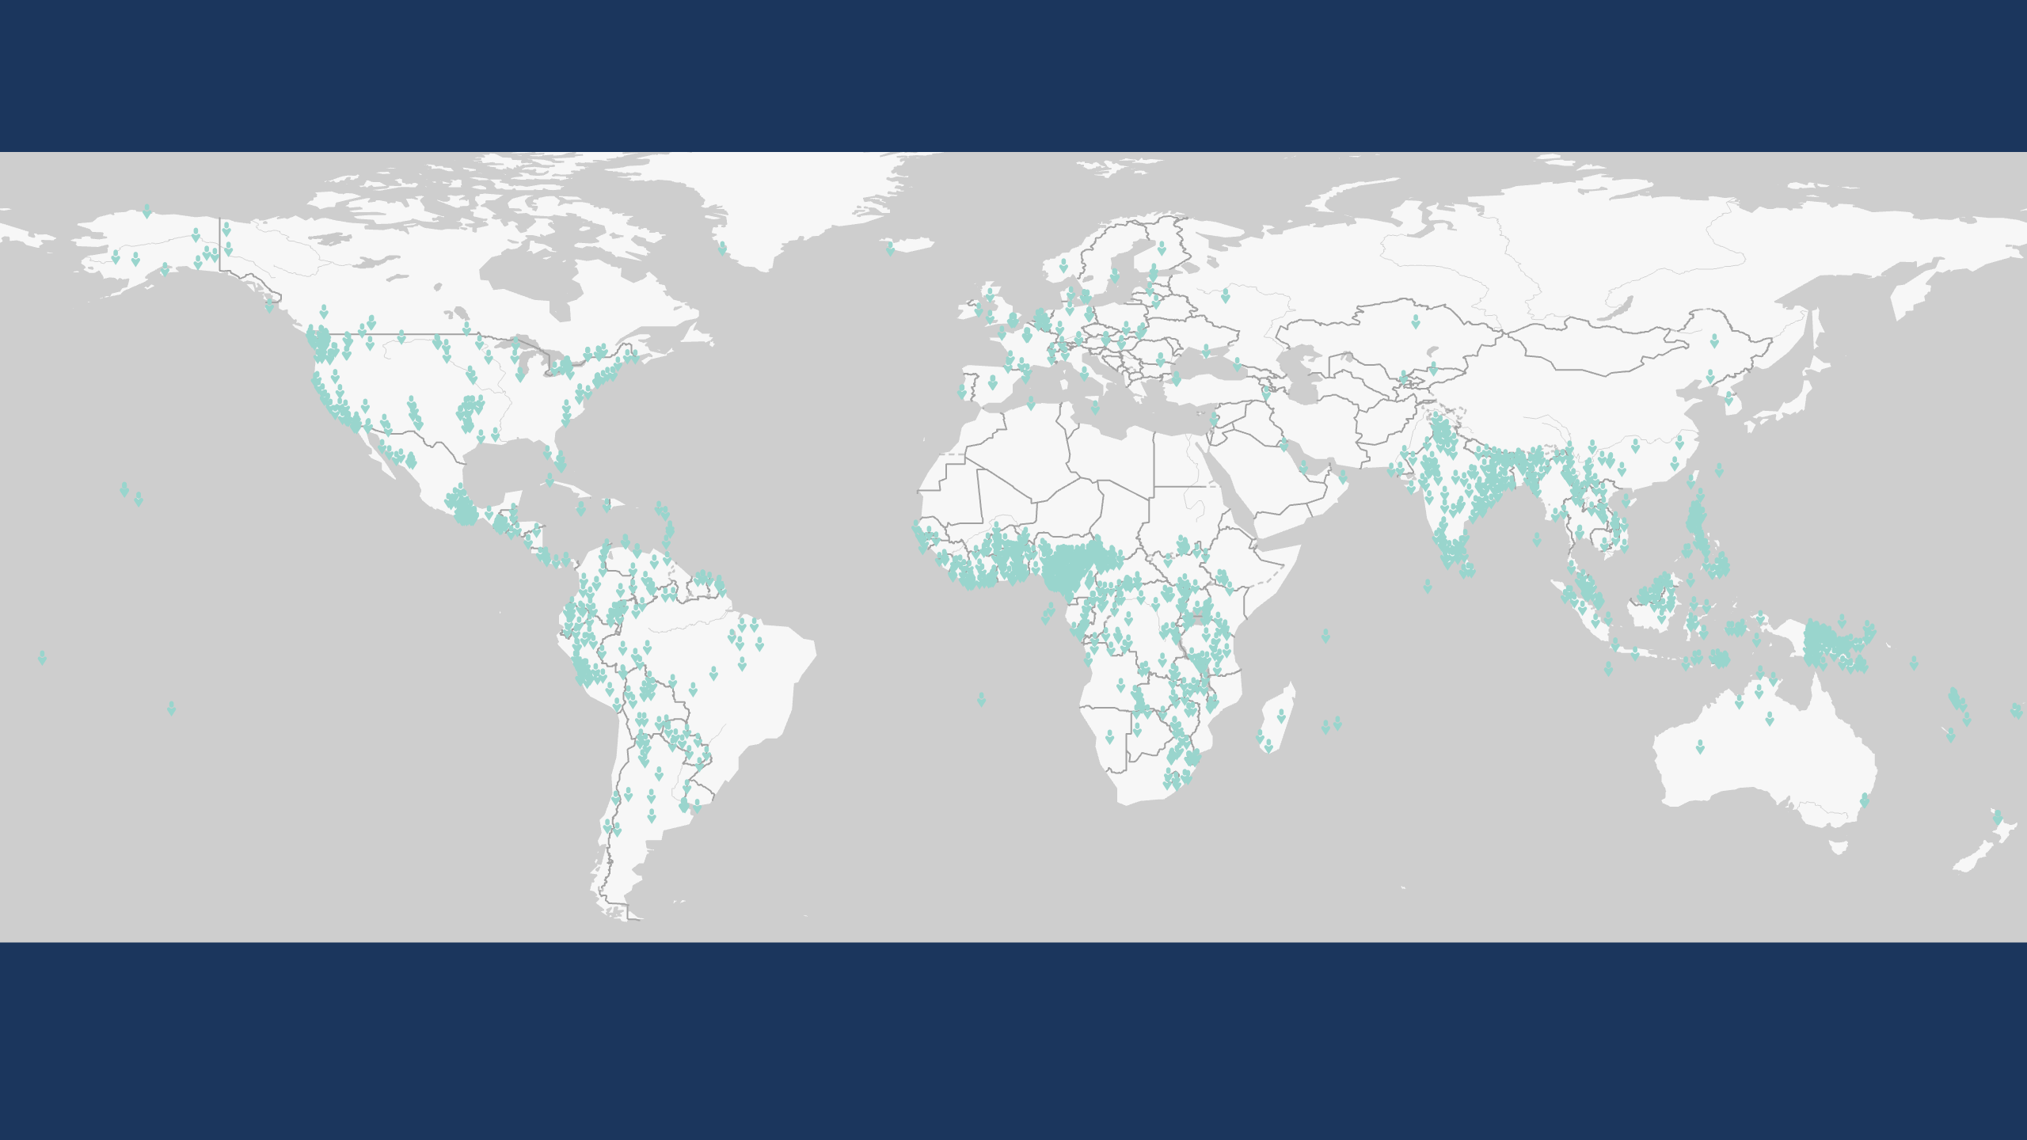
Global Status of Evangelical Christianity
GSEC Status 4
Greater than or equal to 2 percent evangelical.
1,606 people groups with a combined population of 882,155,390 as of January 2024.
Each symbol represents one people group. GSEC values calculated by Global Research, IMB, January 2024. Plate Carrée Projection. Human Geography Basemap by ESRI 2023.
Copyright © 2024 International Mission Board, Global Research
Notes:
1,606 people groups with a total population of 882,155,390 are classified as GSEC 4 as of January 2024. GSEC 4 people groups are greater than or equal to 2% evangelical but less than 5% evangelical.

Slide 9
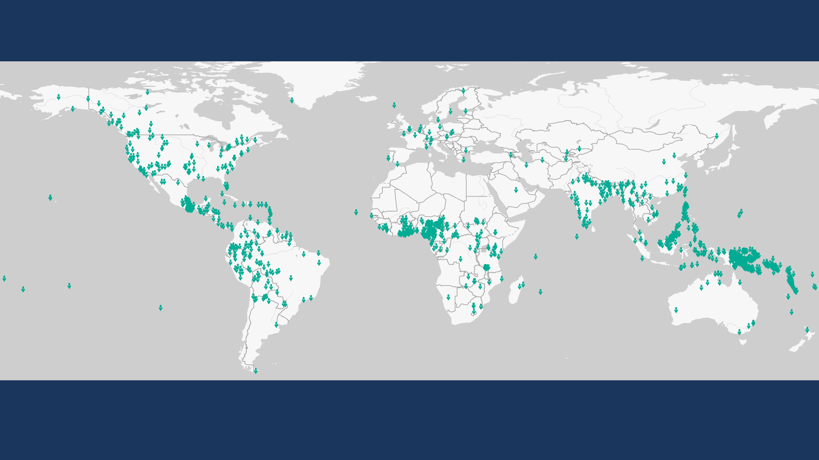
Global Status of Evangelical Christianity
GSEC Status 5
Greater than or equal to 5 percent evangelical.
1,449 people groups with a combined population of 1,821,611,980 as of January 2024.
Each symbol represents one people group. GSEC values calculated by Global Research, IMB, January 2024. Plate Carrée Projection. Human Geography Basemap by ESRI 2023.
Copyright © 2024 International Mission Board, Global Research
Notes:
1,449 people groups with a total population of 1,821,611,980 are classified as GSEC 5 as of January 2024. GSEC 5 people groups are greater than or equal to 5% evangelical but less than 10% evangelical.

Slide 10
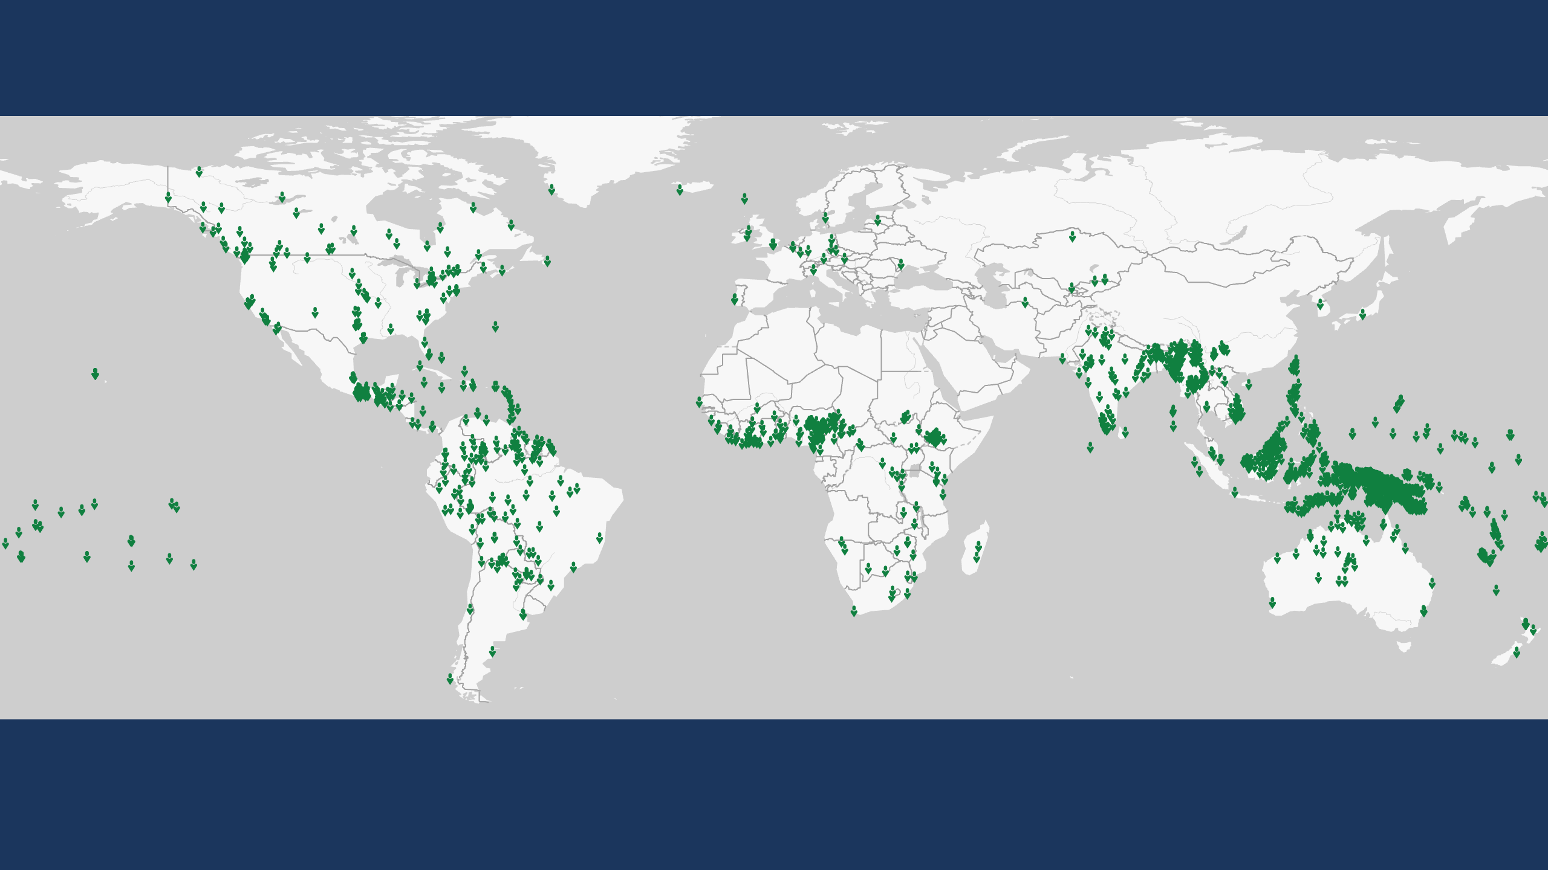
Global Status of Evangelical Christianity
GSEC Status 6
Greater than or equal to 10 percent evangelical.
1,809 people groups with a combined population of 567,974,605 as of January 2024.
Each symbol represents one people group. GSEC values calculated by Global Research, IMB, January 2024. Plate Carrée Projection. Human Geography Basemap by ESRI 2023.
Copyright © 2024 International Mission Board, Global Research
Notes:
1,809 people groups with a total population of 567,974,605 are classified as GSEC 6 as of January 2024. GSEC 6 people groups are greater than or equal to 10% evangelical.

Slide 11
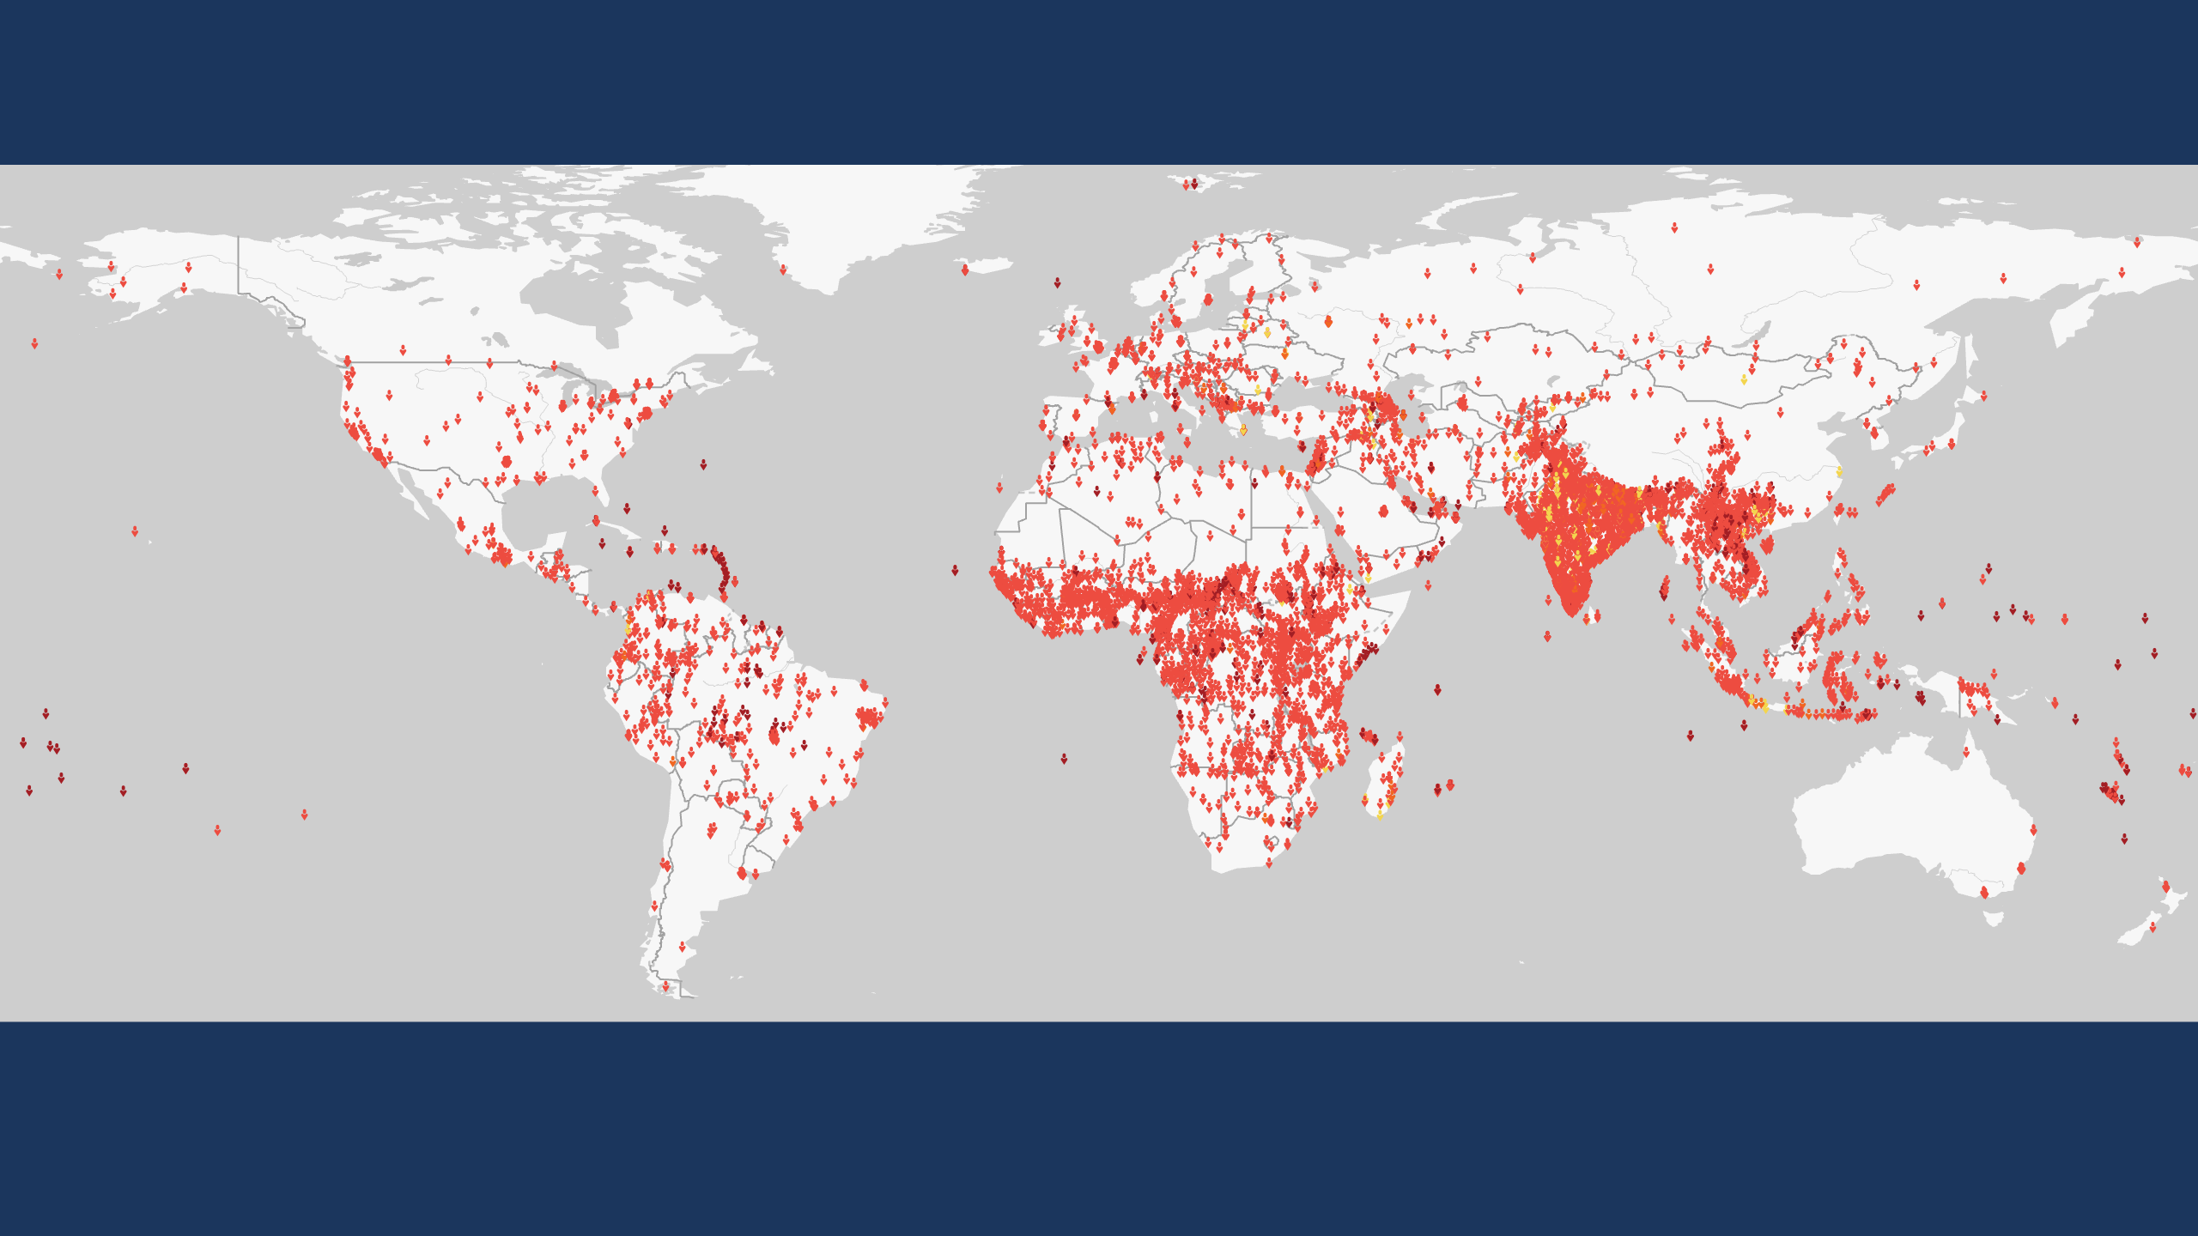
Global Status of Evangelical Christianity
Unreached People Groups
An Unreached People Group (UPG) is a people group with less than 2 percent evangelical Christians.
7,250 people groups with population approaching 4.8 billion are classified as UPGs as of January 2024.
Each symbol represents one people group. GSEC values calculated by Global Research, IMB, January 2024. Plate Carrée Projection. Human Geography Basemap by ESRI 2023.
Copyright © 2024 International Mission Board, Global Research
Notes:
7,250 People Groups with a combined population of 4,763,231,710 are Unreached as of January 2024. An Unreached People Group (UPG) is a people group among whom evangelical Christians comprise less than 2 percent of the population.

