Slide 1
Progress toward Engaging Unreached Peoples
2024 Update
Data Values from 1/1/2024 ArcGIS Service
https://gis.imb.org/arcgis/rest/services/YEAR
Explore an interactive version of the latest Progress Map.

Slide 2
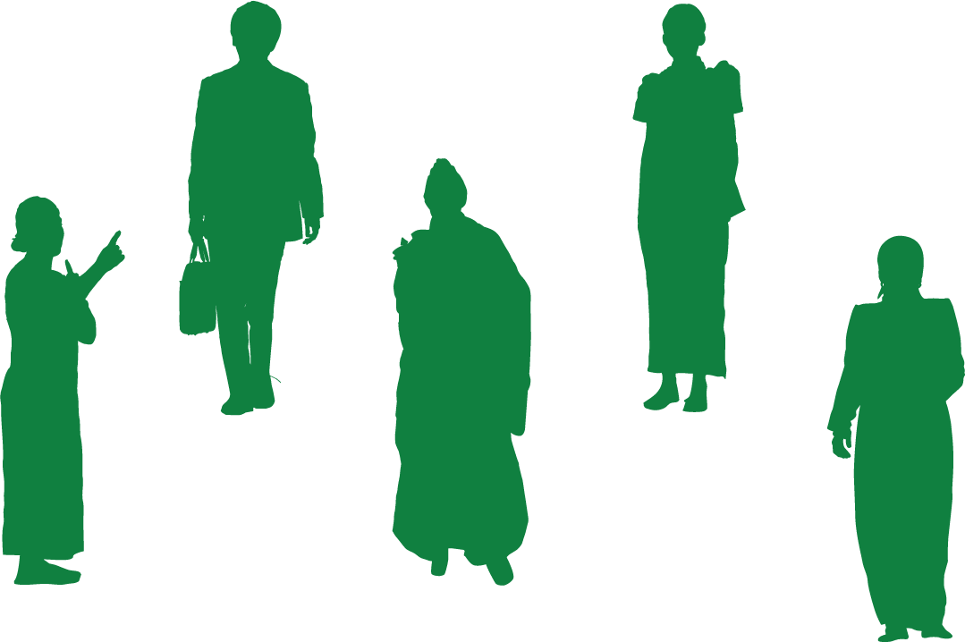
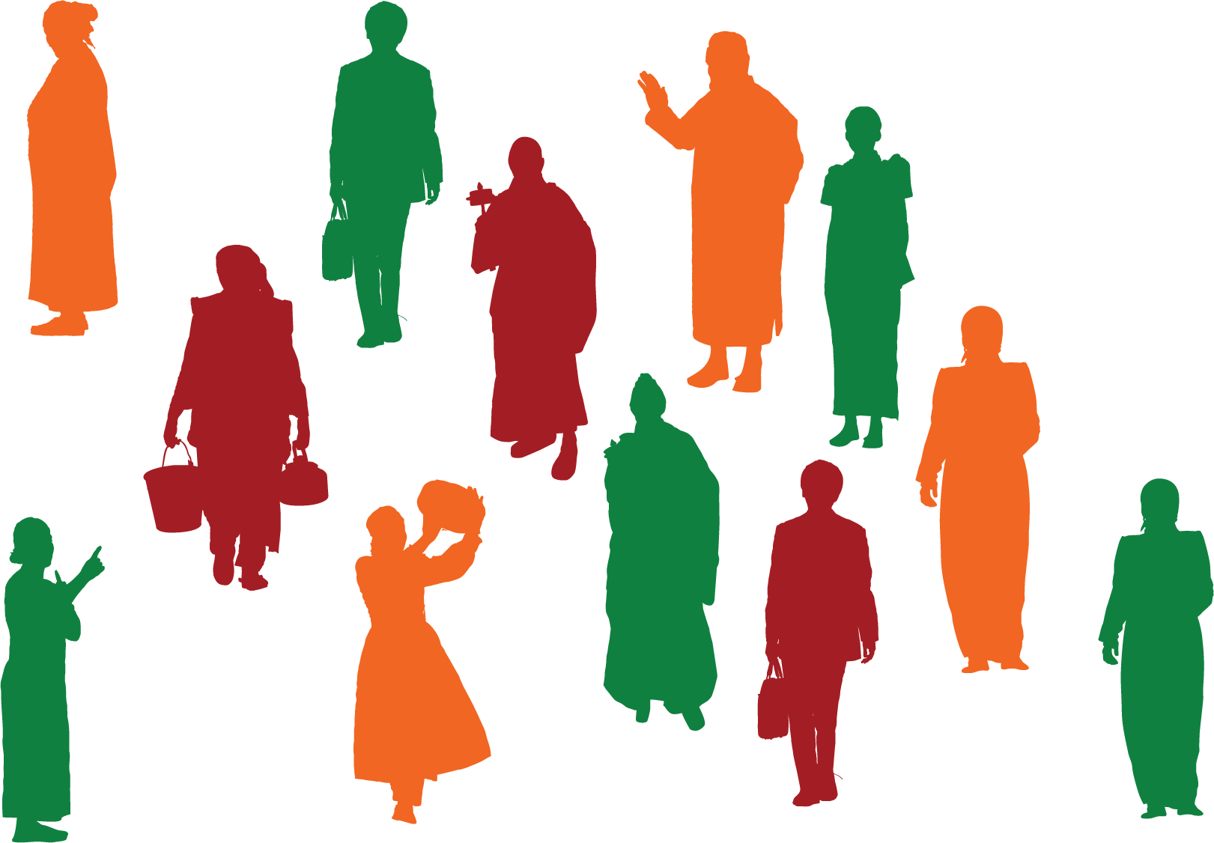
Progress toward Engaging Unreached Peoples
No Longer Unreached
4,864 people groups
(3.3 billion people)
Engaged yet Unreached
4,089 people groups
(4.5 billion people)
12,114 people groups
(8 billion people)
Unreached
7,250 people groups
(4.8 billion people)
Unengaged and Unreached
3,161 people groups
(283 million people)
Who will take the gospel to the 3,161 people groups that remain Unengaged and Unreached?
Notes:
The world’s 8 billion people are distributed among 12,114 unique people groups as of January 1, 2024. A people group is a collection of people who share a common ethnic identity and language. 4,864 people groups are classified as “No Longer Unreached” meaning evangelical believers comprise 2% or more of their population. No Longer Unreached doesn’t mean they are no longer in need of evangelism and church planting efforts. It typically means that there are sufficient evangelicals among them so that they are no longer a priority group for most mission organizations.
7,250 people groups remain classified as Unreached. Unreached means that less than 2% of a group’s population is evangelical Christian. There may be evangelicals among them but in limited numbers. They remain in need of the gospel. But all Unreached people groups are not equal. Among these 7,250 Unreached people groups, 4,089 are currently engaged by one or more evangelical churches or mission organizations. We thank God that so many of the world’s remaining Unreached people groups are currently engaged. These groups account for roughly 56% of the world’s population.
But there is one final category of people groups … those who remain Unengaged and Unreached. These groups have limited, if any, evangelical believers among them. No known evangelical church or mission organization is implementing a church planting strategy among them. Who will take the gospel to these 3,161 people groups? Most of these people groups are relatively small. The average population is just under 90,000. Many are isolated by geography or civil unrest. Many have no scripture in their heart language. The challenge is great. These unengaged and unreached people groups should be the highest priority for mission efforts.
This slide introduces a series of maps showing the geographic distribution of various categories of people groups.

Slide 3
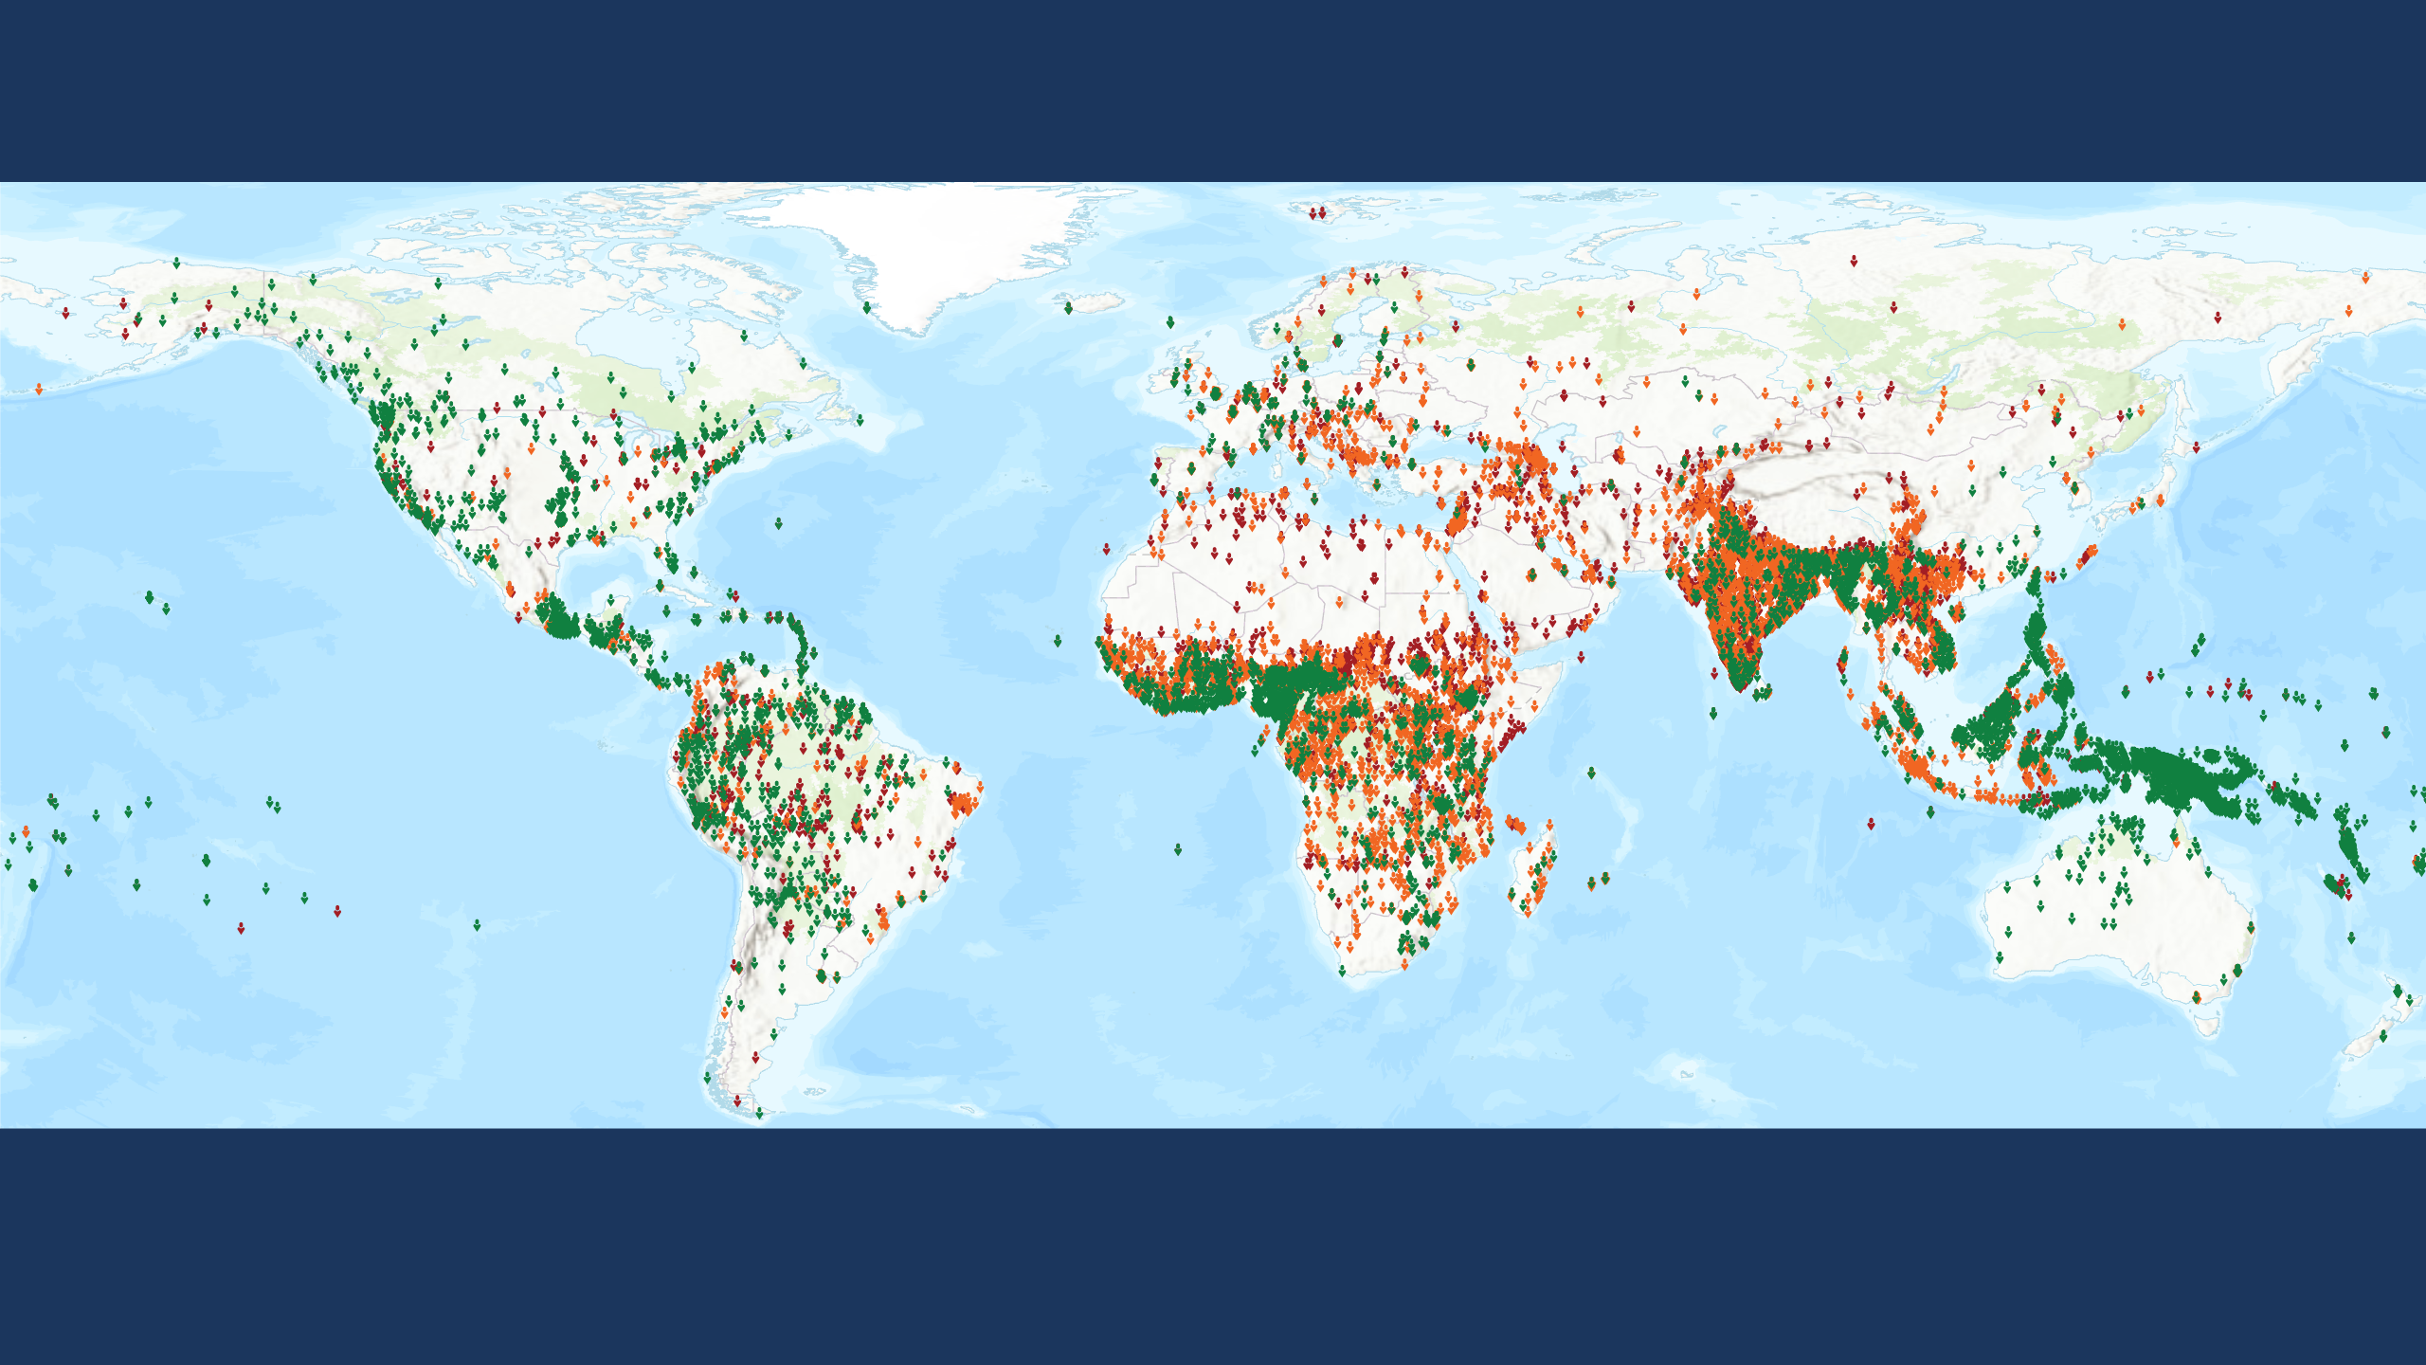
Progress toward Engaging Unreached Peoples
12,114 people groups (8 billion people)
Each symbol represents one people group. Statuses calculated by Global Research, IMB, January 2024. Plate carrée Projection. World Topographic Basemap by ESRI 2023.
Copyright © 2024 International Mission Board, Global Research
Notes:
A people group is a collection of people who share a common self-identity based on culture and language. We sometimes describe a people group as ‘the largest group within which the Gospel can spread without encountering barriers of understanding or acceptance’. Language differences impact understanding of the gospel message. Cultural differences impact acceptance of the gospel messenger. 12,114 people groups with a combined population of just over 8 billion are detailed in the IMB database at the beginning of 2024. Each people group is represented by a single symbol on this map.

Slide 4
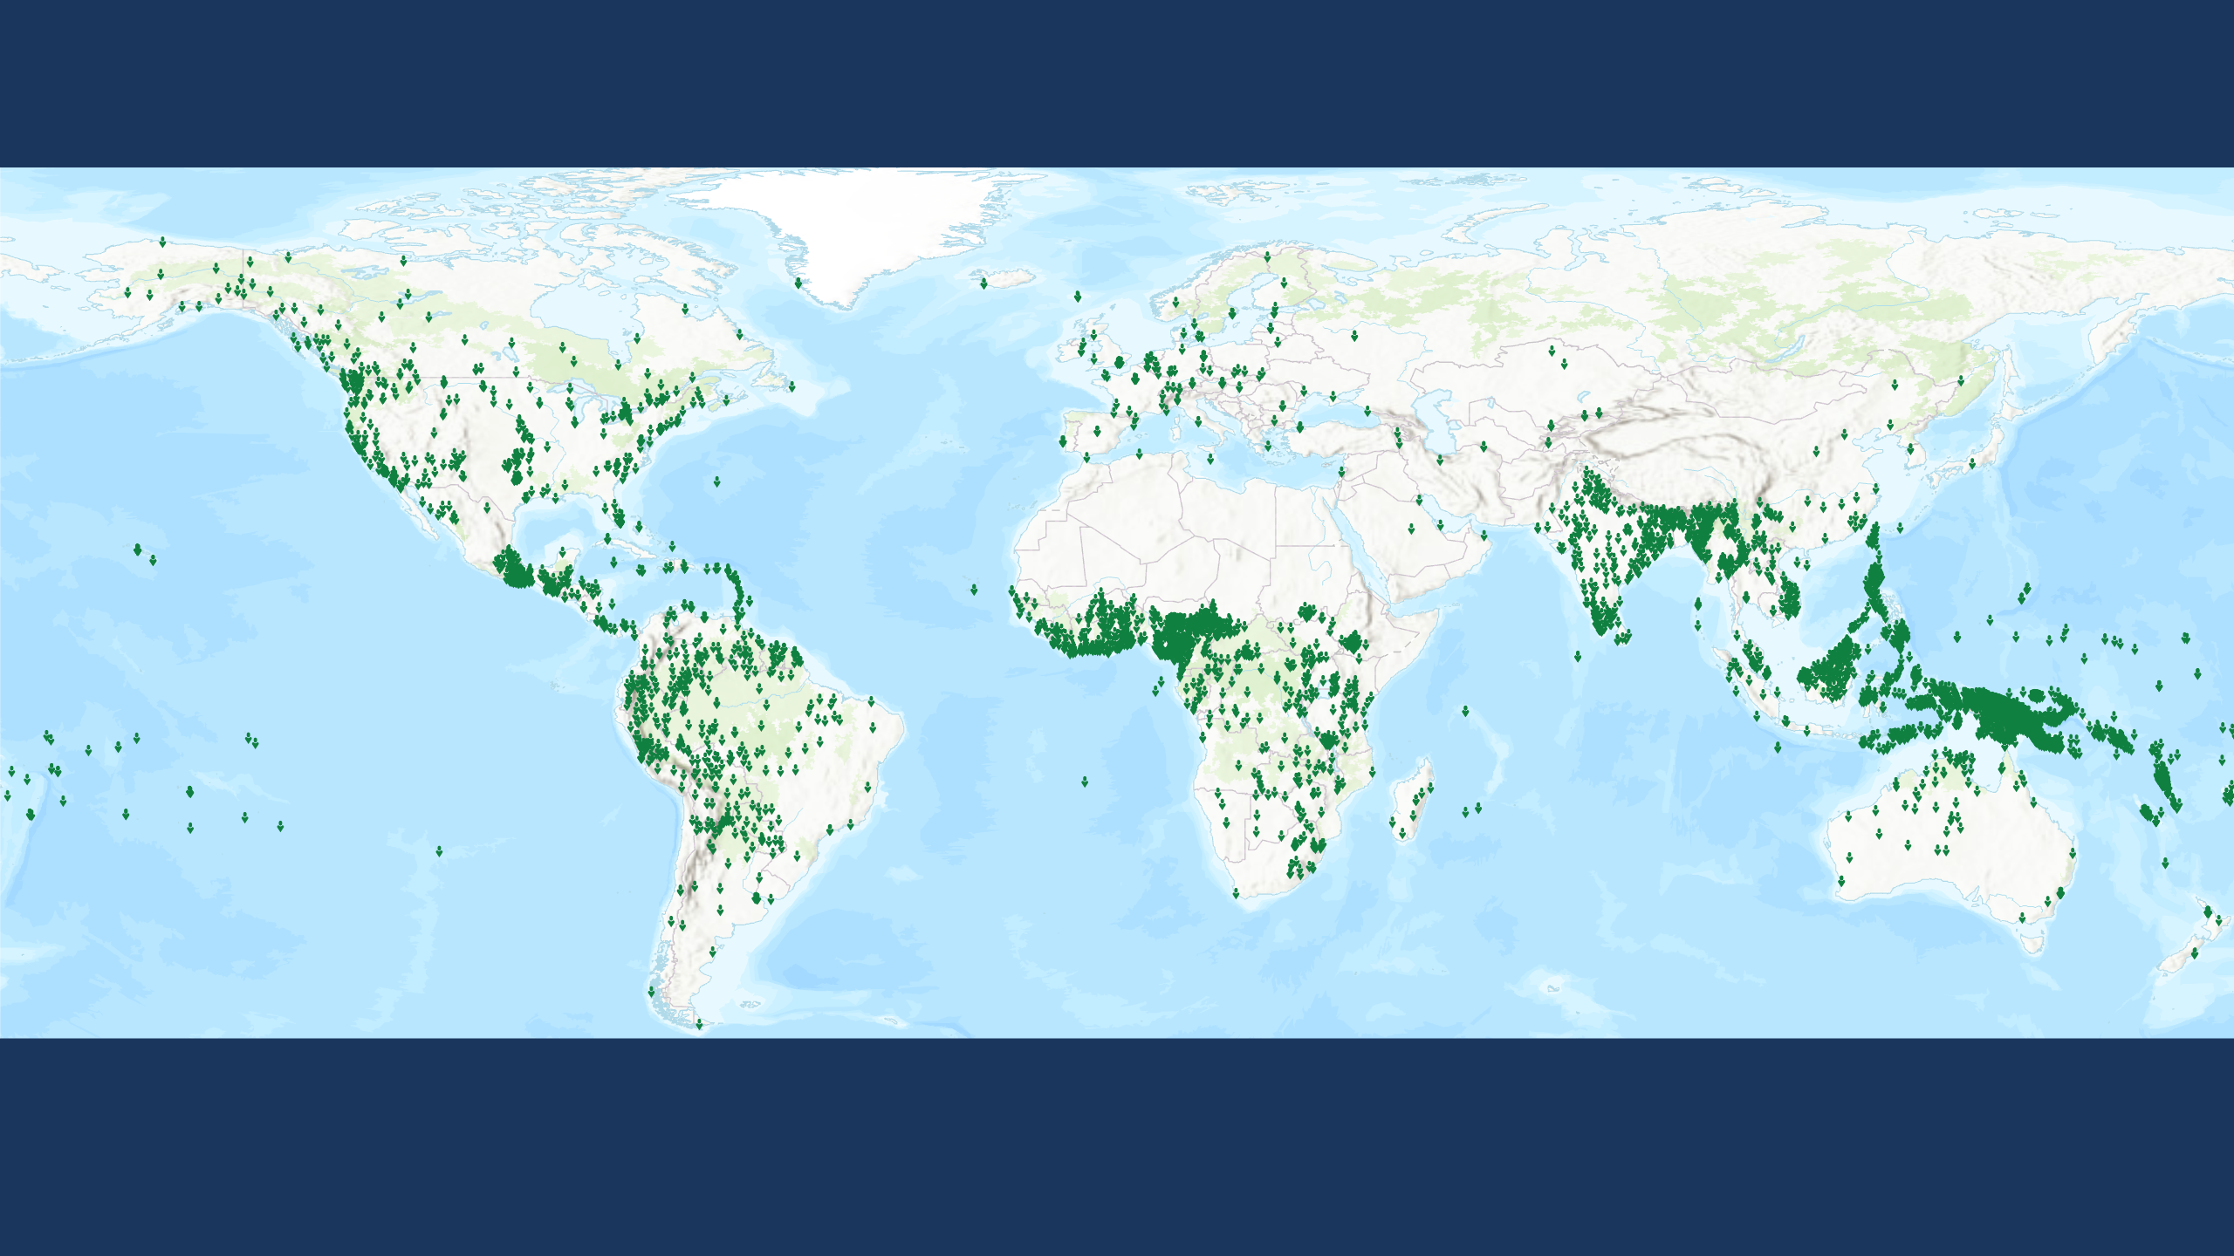
Progress toward Engaging Unreached Peoples
No Longer Unreached
4,864 people groups (3.3 billion people)
Each symbol represents one people group. Statuses calculated by Global Research, IMB, January 2024. Plate carrée Projection. World Topographic Basemap by ESRI 2023.
Copyright © 2024 International Mission Board, Global Research
Notes:
No Longer Unreached people groups are those among whom evangelical Christians account for 2 percent or more of the population. 4,864 No Longer Unreached people groups with a combined population of nearly 3.3 billion are detailed in the IMB database at the beginning of 2024. Each people group is represented by a single symbol on this map.

Slide 5
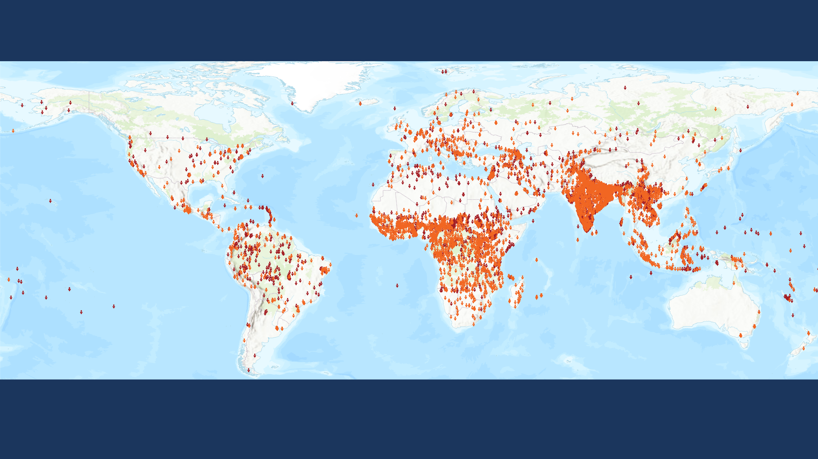
Progress toward Engaging Unreached Peoples
Unreached
7,250 people groups (4.8 billion people)
Each symbol represents one people group. Statuses calculated by Global Research, IMB, January 2024. Plate carrée Projection. World Topographic Basemap by ESRI 2023.
Copyright © 2024 International Mission Board, Global Research
Each point approximates 50,000 people. Statuses are calculated by Global Researc, IMB, January 2023. Robinson World Projection. Physical Basemap by US National Park Service. Geography by ESRI 2020.
Notes:
A people group is considered unreached when they are less than 2 percent evangelical. 7,250 Unreached people groups with a combined population of 4.8 billion are detailed in the IMB database at the beginning of 2024. Each people group is represented by a single symbol on this map.

Slide 6
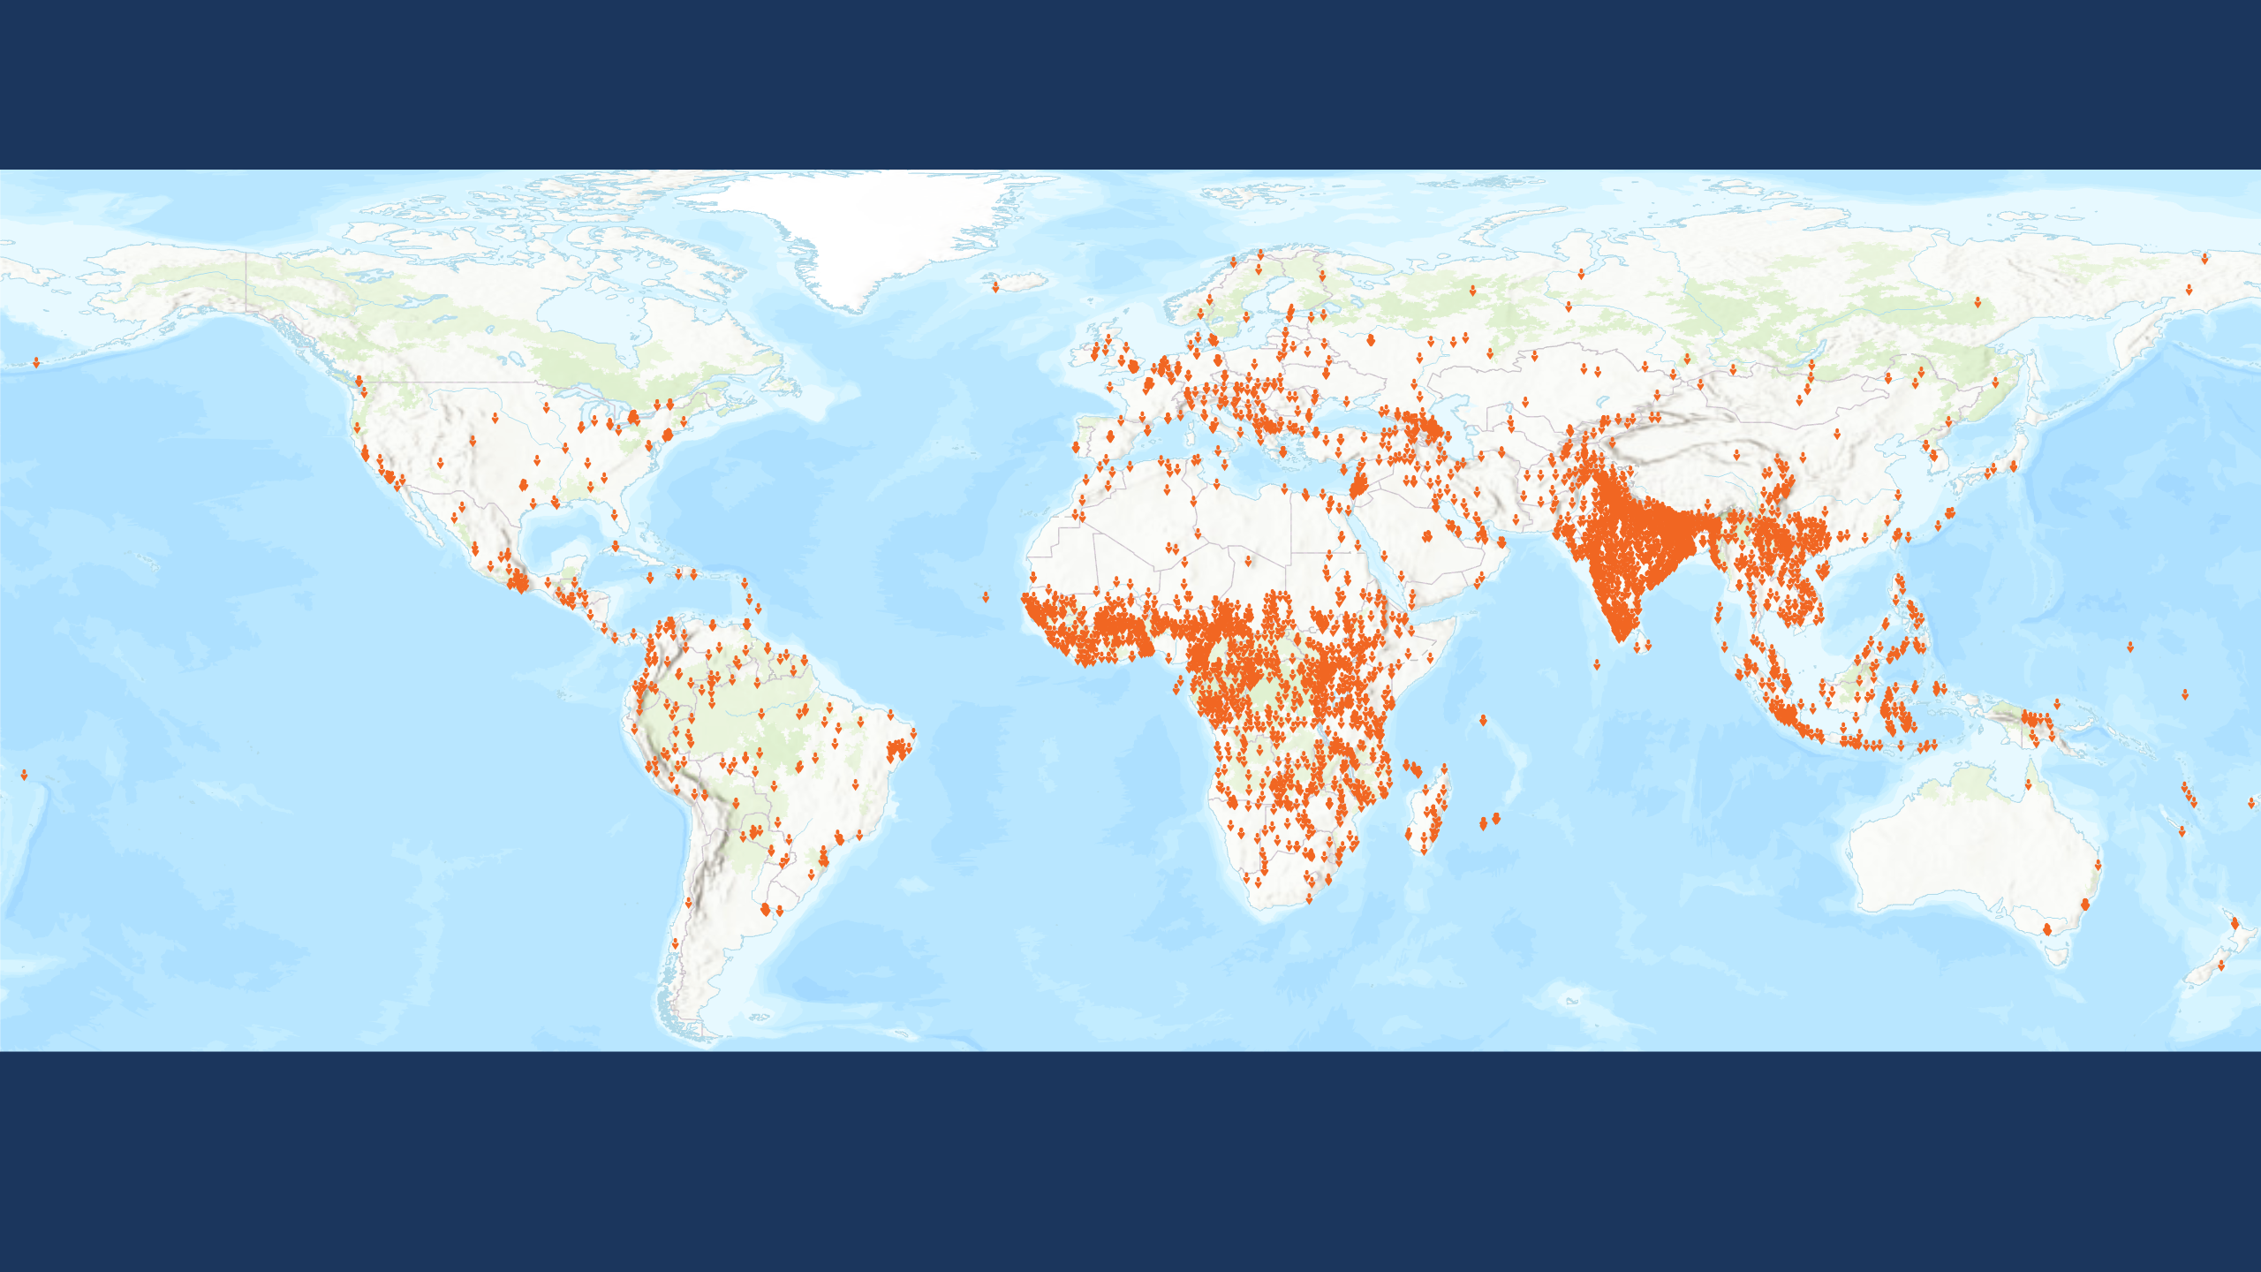
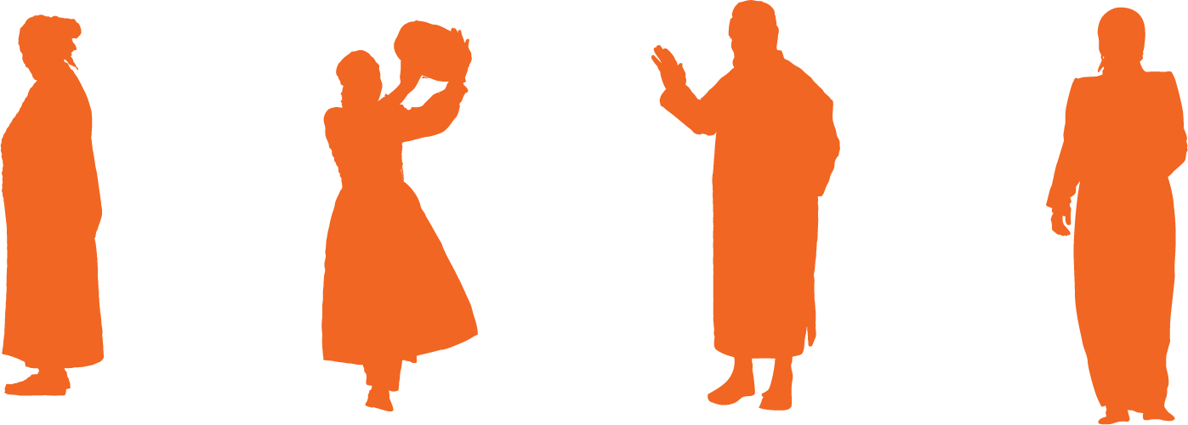
Progress toward Engaging Unreached Peoples
Engaged yet Unreached
4,089 people groups (4.5 billion people)
Each symbol represents one people group. Statuses calculated by Global Research, IMB, January 2024. Plate carrée Projection. World Topographic Basemap by ESRI 2023.
Copyright © 2024 International Mission Board, Global Research
Notes:
A people group is engaged when a church planting strategy is being implemented among them. More than half of the world’s Unreached people groups are currently reported as engaged by one or more evangelical churches or organizations. 4,089 Engaged yet Unreached people groups with a combined population of 4.5 billion are detailed in the IMB database at the beginning of 2024. Each people group is represented by a single symbol on this map.

Slide 7
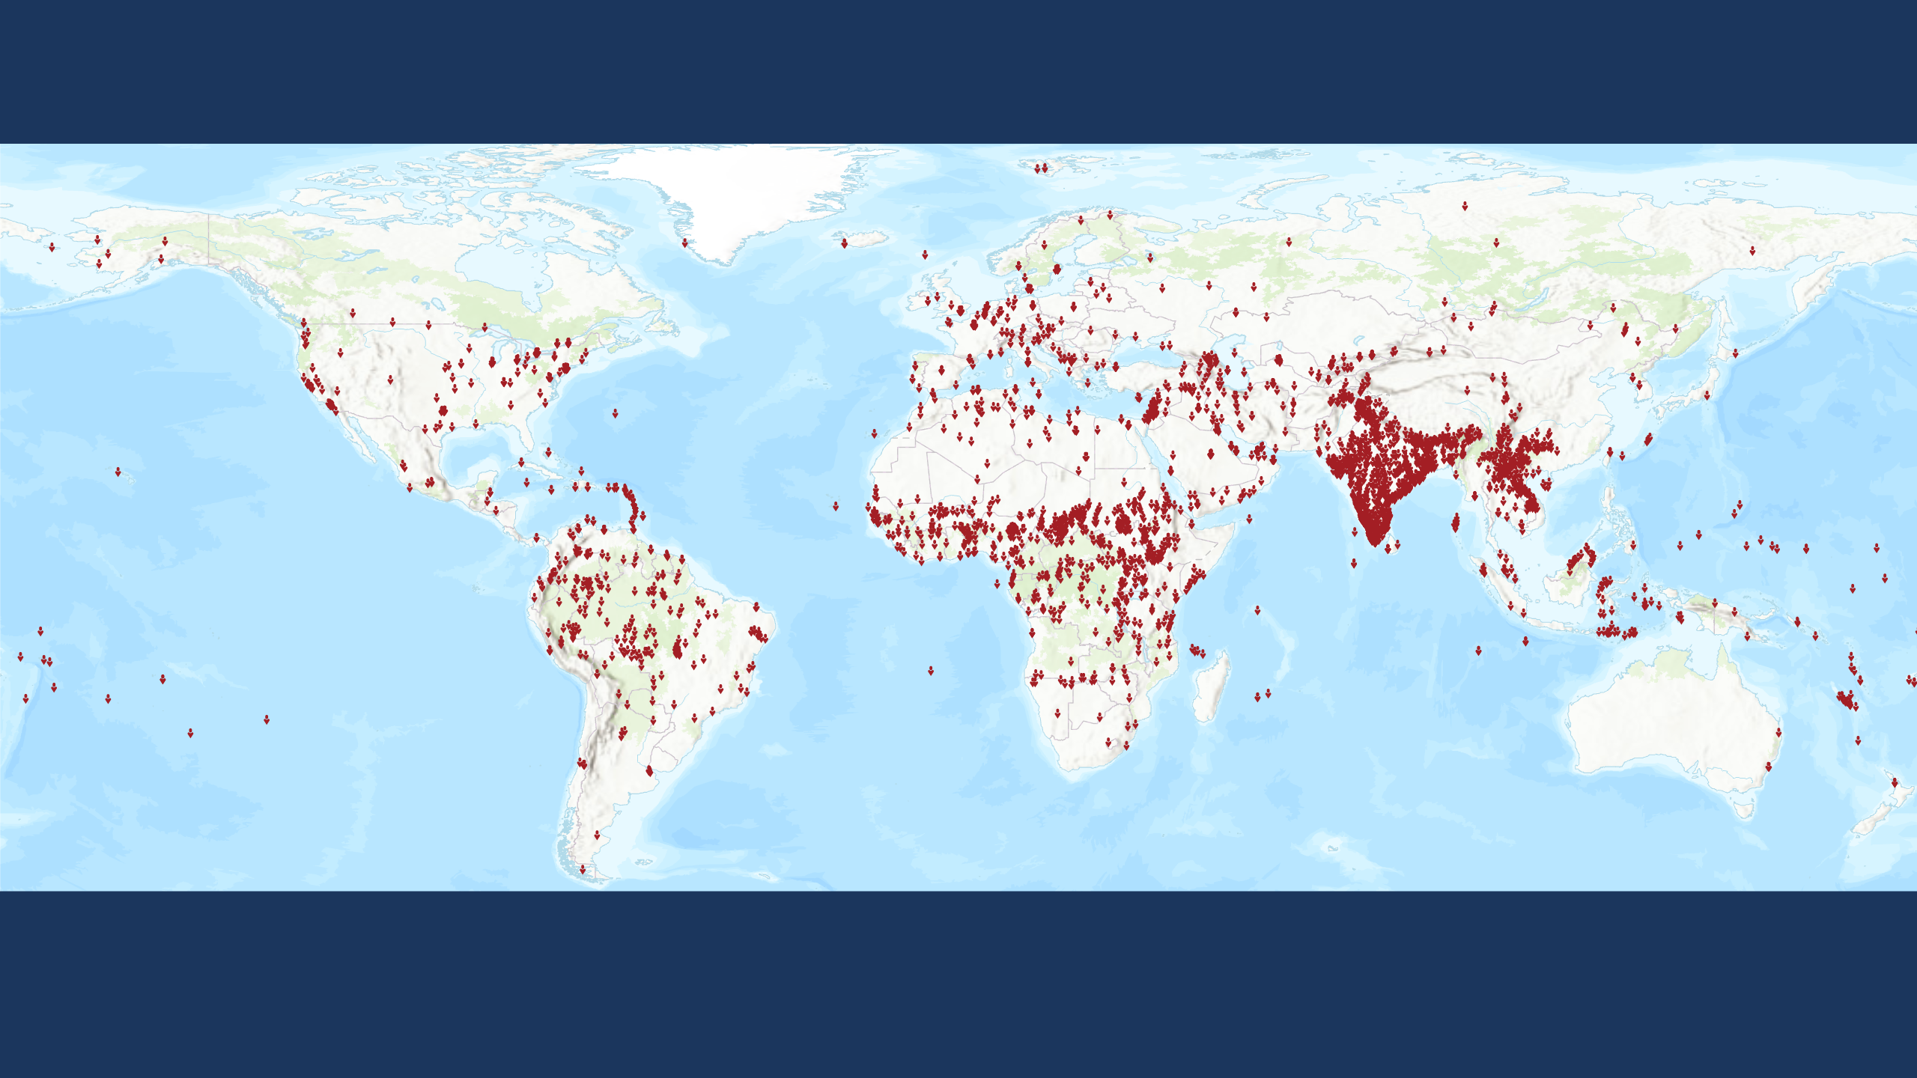
Progress toward Engaging Unreached Peoples
Unengaged and Unreached
3,161 people groups (283 million people)
Each symbol represents one people group. Statuses calculated by Global Research, IMB, January 2024. Plate carrée Projection. World Topographic Basemap by ESRI 2023.
Copyright © 2024 International Mission Board, Global Research
Notes:
Unengaged and Unreached people groups are those less than 2 percent evangelical among whom there is no indigenous community of evangelical Christians nor outside church or mission group implementing a church planting strategy. 3,161 Unengaged and Unreached people groups with a combined population of 283 million are detailed in the IMB database at the beginning of 2024. Each people group is represented by a single symbol on this map.

